Slide 1



Starting Soon:
LNAPLs Training – Part 3 of 3
Light Non-Aqueous Phase Liquid (LNAPL) Site Management: LCSM Evolution, Decision Process, and Remedial Technologies (LNAPL-3, 2018) - https://lnapl-3.itrcweb.org/
Download PowerPoint file
  Clu-in training page at https://clu-in.org/conf/itrc/LNAPL-3/
  Under “Download Training Materials”
Download information for reference during class
  Figure 1.1 (from the LNAPL-3 guidance document)
Using Adobe Connect
  Related Links (on right)
    Select name of link
    Click “Browse To”
  Full Screen button near top of page
Poll Question
Follow ITRC
Notes:
How many different LNAPL remedial technologies have you APPLIED/USED at your sites?
1-4
5-8
9-12
13-16
17 or more

Slide 2
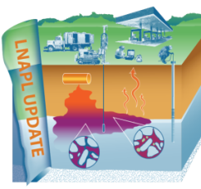
Part 1: Understanding LNAPL Behavior in the Subsurface
Welcome – Thanks for Joining
this ITRC Training Class
Based on ITRC Guidance Document:
Light Non-Aqueous Phase Liquid (LNAPL) Site Management: LCSM Evolution, Decision Process, and Remedial Technologies (LNAPL-3, 2018)
3-Part Training Series: Connecting the Science to Managing Sites
Part 2: LNAPL Conceptual Site Models and the LNAPL Decision Process
Part 3: Using LNAPL Science, the LCSM, and LNAPL Goals to Select an LNAPL Remedial Technology
Sponsored by: Interstate Technology and Regulatory Council (www.itrcweb.org) Hosted by: USEPA Clean Up Information Network (www.cluin.org)
Notes:
The newly updated LNAPLs (Light Non-Aqueous Phase Liquids) training courses help users set appropriate LNAPL remedial goals in the context of a site-specific LNAPL conceptual site model, provide tools to screen LNAPL remedial technologies to identify an optimal LNAPL remedial technology to achieve the goals, and provide example performance metrics that would be set to gauge remedial effectiveness and demonstrate achievement of the goals.
A sound LNAPL understanding is necessary to effectively characterize and assess LNAPL conditions and potential risks, as well as to evaluate potential remedial technologies or alternatives. The ITRC LNAPLs Team’s updated training courses provide:
a technical understanding of LNAPL key concepts and behavior in the subsurface
LNAPL conceptual site model (LCSM) development
framework for making LNAPL remediation and management decisions
informed remedial technology selection and appropriate technology application
LNAPL Training Part 1: An Improved Understanding of LNAPL Behavior in the Subsurface - Connecting the Science to Managing Sites
Part 1 explains how LNAPLs behave in the subsurface and examines what controls their behavior. Part 1 also explains what LNAPL data can tell you about the LNAPL and site conditions. Relevant and practical examples are used to illustrate key concepts.
LNAPL Training Part 2: LNAPL Conceptual Site Models and Remedial Decision Framework - Do you know where the LNAPL is and how to address LNAPL concerns?
Part 2 addresses LNAPL conceptual site model (LCSM) development as well as the overall framework for making LNAPL remediation and management decisions. Part 2:
discusses key LNAPL and site data
when and why those data may be important, and
how to effectively organize the data into an LCSM.
Part 2 also discusses how to resolve LNAPL concerns by selecting appropriate goals and objectives, choosing applicable technologies, and assigning remedial performance metrics and endpoints. Part 2 concludes with a special focus on LNAPL Transmissivity and how it may be used to improve LNAPL decision making.
LNAPL Training Part 3: Using LNAPL Science, the LCSM, and LNAPL Goals to Select an LNAPL Remedial Technology
Part 3 of the training fosters informed remedial technology selection and appropriate technology application. Part 3:
discusses remedial technology groups,
introduces specific remedial technologies,
provides a framework for technology selection, and
introduces a series of tools to screen the several remedial technologies addressed in the updated ITRC document.
A case study demonstrates the use of these tools for remedial technology selection, implementation, and demonstration of successful remediation.
ITRC (Interstate Technology and Regulatory Council) www.itrcweb.org
Training Co-Sponsored by: US EPA Technology Innovation and Field Services Division (TIFSD) (www.clu-in.org)
ITRC Training Program: training@itrcweb.org; Phone: 402-201-2419

Slide 3
Housekeeping
Course time is 2¼ hours
This event is being recorded
Trainers control slides
  Want to control your own slides? You can download presentation file on Clu-in training page
Questions and feedback
  Throughout training:
  type in the “Q & A” box
  At Q&A breaks: unmute your phone with #6 to ask out loud
  At end of class: Feedback form available from last slide
    Need confirmation of your participation today? Fill out the feedback form and check box for confirmation email and certificate
Copyright 2019 Interstate Technology & Regulatory Council,
50 F Street, NW, Suite 350, Washington, DC 20001
Notes:
3
Notes:
We have started the seminar with all phone lines muted to prevent background noise. Please keep your phone lines muted during the seminar to minimize disruption and background noise. During the question and answer break, press #6 to unmute your lines to ask a question (note: *6 to mute again). Also, please do NOT put this call on hold as this may bring unwanted background music over the lines and interrupt the seminar.
Use the “Q&A” box to ask questions, make comments, or report technical problems any time. For questions and comments provided out loud, please hold until the designated Q&A breaks.
Everyone – please complete the feedback form before you leave the training website. Link to feedback form is available on last slide.

Slide 4





ITRC (www.itrcweb.org) – Shaping the Future of Regulatory Acceptance
Host organization
Network
  State regulators
    All 50 states, PR, DC
  Federal partners
  ITRC Industry Affiliates Program
  Academia
  Community stakeholders
Follow ITRC
Disclaimer
  Full version in “Notes” section
  Partially funded by the U.S. government
    ITRC nor US government warranty material
    ITRC nor US government endorse specific products
ITRC materials available for your use – see usage policy
Available from www.itrcweb.org
  Technical and regulatory guidance documents
  Online and classroom training schedule
  More…
DOE
DOD
EPA
Notes:
Notes:
The Interstate Technology and Regulatory Council (ITRC) is a state-led coalition of regulators, industry experts, citizen stakeholders, academia and federal partners that work to achieve regulatory acceptance of environmental technologies and innovative approaches. ITRC consists of all 50 states (and Puerto Rico and the District of Columbia) that work to break down barriers and reduce compliance costs, making it easier to use new technologies and helping states maximize resources. ITRC brings together a diverse mix of environmental experts and stakeholders from both the public and private sectors to broaden and deepen technical knowledge and advance the regulatory acceptance of environmental technologies. Together, we’re building the environmental community’s ability to expedite quality decision making while protecting human health and the environment. With our network of organizations and individuals throughout the environmental community, ITRC is a unique catalyst for dialogue between regulators and the regulated community.
For a state to be a member of ITRC their environmental agency must designate a State Point of Contact. To find out who your State POC is check out the “contacts” section at www.itrcweb.org. Also, click on “membership” to learn how you can become a member of an ITRC Technical Team.
Disclaimer: This material was prepared as an account of work sponsored by an agency of the United States Government. Neither the United States Government nor any agency thereof, nor any of their employees, makes any warranty, express or implied, or assumes any legal liability or responsibility for the accuracy, completeness, or usefulness of any information, apparatus, product, or process disclosed, or represents that its use would not infringe privately owned rights. Reference herein to any specific commercial product, process, or service by trade name, trademark, manufacturer, or otherwise does not necessarily constitute or imply its endorsement, recommendation, or favoring by the United States Government or any agency thereof. The views and opinions of authors expressed herein do not necessarily state or reflect those of the United States Government or any agency thereof and no official endorsement should be inferred.
The information provided in documents, training curricula, and other print or electronic materials created by the Interstate Technology and Regulatory Council (“ITRC” and such materials are referred to as “ITRC Materials”) is intended as a general reference to help regulators and others develop a consistent approach to their evaluation, regulatory approval, and deployment of environmental technologies. The information in ITRC Materials was formulated to be reliable and accurate. However, the information is provided "as is" and use of this information is at the users’ own risk.
ITRC Materials do not necessarily address all applicable health and safety risks and precautions with respect to particular materials, conditions, or procedures in specific applications of any technology. Consequently, ITRC recommends consulting applicable standards, laws, regulations, suppliers of materials, and material safety data sheets for information concerning safety and health risks and precautions and compliance with then-applicable laws and regulations. ITRC, ERIS and ECOS shall not be liable in the event of any conflict between information in ITRC Materials and such laws, regulations, and/or other ordinances. The content in ITRC Materials may be revised or withdrawn at any time without prior notice.
ITRC, ERIS, and ECOS make no representations or warranties, express or implied, with respect to information in ITRC Materials and specifically disclaim all warranties to the fullest extent permitted by law (including, but not limited to, merchantability or fitness for a particular purpose). ITRC, ERIS, and ECOS will not accept liability for damages of any kind that result from acting upon or using this information.
ITRC, ERIS, and ECOS do not endorse or recommend the use of specific technology or technology provider through ITRC Materials. Reference to technologies, products, or services offered by other parties does not constitute a guarantee by ITRC, ERIS, and ECOS of the quality or value of those technologies, products, or services. Information in ITRC Materials is for general reference only; it should not be construed as definitive guidance for any specific site and is not a substitute for consultation with qualified professional advisors.

Slide 5

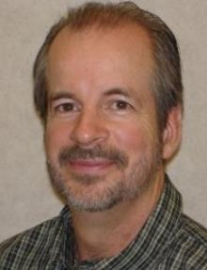


Meet the ITRC LNAPL Trainers – Part 3
Justin Meredith
Tennessee Dept.
of Environment and Conservation
Nashville, Tennessee
615-532-9304
Justin.M.Meredith@tn.gov
Lloyd Dunlap
Trihydro
Kansas City, Missouri
816-550-3961
ldunlap@trihydro.com
Joann Dyson
GHD Services Inc.
Durham, North Carolina
980-221-8044
Joann.Dyson@ghd.com
Tom Palaia
Jacobs Engineering Kittredge, Colorado
303-679-2510
Tom.Palaia@jacobs.com
Read trainer bios at
https://clu-in.org/conf/itrc/LNAPL-3/
Notes:
Justin Meredith is an environmental consultant at the Tennessee Department of Environment and Conservation (TDEC) Nashville, Tennessee. Justin has worked with the Division of Remediation (DoR) since 2016. He is the petroleum contamination remediation expert, a human health and ecological risk assessor, and project manager. Justin provides technical assistance to other project managers across the state programs including drycleaners, brownfields, NPL, and voluntary sites. Justin routinely presents at conferences and has trained several hundred individuals including internal staff as well as external consultants on several aspects involved in the remediation process (proper sampling procedures, site characterization, remediation tech selection) Prior to TDEC-DoR, he worked for 4 years in TDEC-Underground Storage Tanks program and prior to that worked in the private sector, as a field geologist, for 4 years with environmental chemical corporation. Justin is a trainer for ITRC's training course on LNAPL remediation technology overview. Justin has been active in ITRC since 2014 and is serving as Tennesseeâ€™s ITRC Point of Contact, and is a current team member for the ITRC PFASs team. Previous ITRC teams participated on include remediation management of complex sites and the LNAPL update teams. Justin earned a bachelor's degree in environmental geosciences from Valdosta State University in Valdosta, Georgia in 2008.
Tom Palaia is a Principal Technologist at Jacobs Engineering in Denver, Colorado. Since 1992, Tom has worked at Jacobs/CH2M specializing in characterization and remediation of petroleum non-aqueous phase liquids (NAPL). As the Petroleum NAPL Community of Practice leader for Jacobs, Tom's central role for the firm is focused on quality control and ensuring that state-of-the-practice remediation approaches are implemented on projects world-wide. Additionally, he is responsible for participating in technical workgroups, conducting seminars, and presenting new technology applications to site owners and regulatory agencies. Tom has dedicated a large part of his career to facilitating application of best practice and technology transfer, and training of many practitioners within CH2M/Jacobs. Tom is passionate about the future direction of advanced technology for remediation and is working hard to expedite the advance and practical use of new science. Tom is new to ITRC's training team, active in the ITRC LNAPL Update Team since 2016. Tom earned a bachelor's degree in civil engineering from the Lafayette College in Easton, Pennsylvania in 1990 and a master's in environmental engineering from the University of Massachusetts in Amherst, Massachusetts in 1992. Tom is a registered Professional Engineer in the State of Colorado and Province of Alberta, Canada
Lloyd E. Dunlap is a Senior Geologist with Trihydro in Kansas City, Missouri. Lloyd has worked for Trihydro since 2015. Lloyd works on special projects in the hydrocarbon remediation area. He has experience in environmental, energy, and regulatory issues, plus RCRA Corrective Action and Strategic Planning for complex sites. Lloyd worked in multiple environmental positions at BP from 1982 until 2012. He managed projects under the jurisdiction of Resource Conservation and Recovery Act (RCRA), Comprehensive Environmental Response, Compensation, and Liability Act (CERCLA), the European Union, administrative orders on consent, and state programs in nearly every state. He has authored numerous publications and often speaks at environmental conferences about regulatory issues and trends. Since 2015, Lloyd has been a member of the ITRC Light Non-aqueous Phase Liquids (LNAPL) and serves as an ITRC trainer. Lloyd earned a bachelor's degree in Geology from the University of Kansas in Lawrence, Kansas, in 1975 and a Master of Science in Geology/Hydrogeology from Kansas State University in Manhattan, Kansas, in 1977. Lloyd is a Professional Geologist in the State of Florida.
Joann Dyson, Ph.D., is an Environmental Specialist with GHD in the Contaminated Assessment & Remediation service line and is located in Durham, North Carolina. Although new to GHD in 2019, she has been working at LNAPL-contaminated sites since 1999. Joann specializes in investigation and remediation of LNAPL sites, including investigation of soil, groundwater and vapor contamination, conceptual site model development, and remediation design for techniques such as excavation and multi-phase extraction. She has performed many risk-assessments at contaminated sites, determining the best solution for the site, client and regulatory agency. She has also been involved with special projects such as international LIF investigations; state terrorism preparedness, including WMD debris management; emergency response ICS training for cities, counties, and government agencies such as the Minnesota Pollution Control Agency (MPCA), and environmental conference presentations. Joann has been active in the ITRC since 2016 as a member of the LNAPL Update team and the Implementing Advanced Site Characterization Tools (ASCT) team. She received the 2017 Industry Affiliates Program (IAP) Award for contributions to the LNAPL Update team. Prior to environmental consulting, Joann was an Assistant Professor of Physics at Beloit College (1996-1998) and Gettysburg College (1994-1996). Joann earned a Bachelor of Science degree in physics from Wake Forest University in Winston-Salem, North Carolina in 1988 and a Ph.D. in physics from the University of Georgia in Athens, Georgia in 1994.

Slide 6
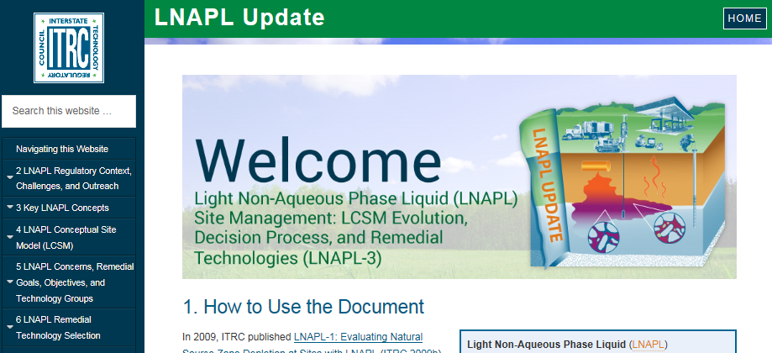
Your Online LNAPL Resource https://lnapl-3.itrcweb.org/
Expansion of LNAPL Key Concepts
Development of a LNAPL Conceptual Site Model (LCSM) Section
Emphasis on identifying SMART goals
Expansion of Transmissivity (Tn) and Natural Source Zone Depletion (NSZD) via Appendices
Notes:
Welcome to Part three of our ITRC LNAPL training series. We assume everyone attended Part 1 and 2 and we will quickly move into our Part 3 content.
As a reminder, the ITRC LNAPL-3 document in on the web-site (link provided on the slide). The updated included the expansion of key concepts, a completely new LCSM section, a focus on SMART goals, and expanded content on Tn and NSZD. We encourage you to use the document.

Slide 7
LNAPL Science: Key to Improving Decision-making
LNAPL Part 1 and 2 Summary
Use LNAPL science and its application to make good decisions at your site
Develop LCSM for LNAPL concern identification and establish appropriate LNAPL remedial goals and objectives
It is important to use your LCSM to help select remedial technology to achieve goals
Notes:
The main take away from Parts 1 and 2 is that you need to Use LNAPL science and its application to make good decisions at your site. And use that information to Develop a LCSM for LNAPL concern identification and establish appropriate LNAPL remedial goals and objectives

Slide 8
Learning Objectives
3-Part Training Series
Part 1
Use LNAPL science to your advantage and apply at your sites
Develop LNAPL Conceptual Site Model (LCSM) for LNAPL concern identification
Inform stakeholders about the decision-making process
Select remedial technologies to achieve objectives
Prepare for transition between LNAPL strategies or technologies as the site moves through investigation, cleanup, and beyond
“SMART”-ly measure progress toward an identified technology-specific endpoint
Part 2
Part 3
Notes:
As noted in the previous parts of the training, our 3-part training series provides you with the knowledge and skills so you can apply the newest ITRC LNAPL guidance at your sites (and for the case of you regulators, potentially help you integrate LNAPL science into your own state guidance).
Our learning objectives for this 3-part series.
Part 1 we covered key concepts to help you understand LNAPL science and how it can be applied to your advantage at your sites.
Last week in Part 2 we covered
Develop a comprehensive LCSM for the purpose of identifying specific LNAPL concerns.
From that, establish appropriate LNAPL remedial goals and specific, measurable, attainable, relevant, and time-bound (or SMART) objectives for these concerns.
Inform stakeholders of the capability and limitations of various LNAPL remedial technologies.
Part 3 (today)
Select remedial technologies that will best achieve the overall remedial goals for a site.
Describe the process to transition between LNAPL strategies or technologies as the site moves through investigation, cleanup, and beyond.
Evaluate the implemented remedial technologies to measure progress toward an identified technology specific endpoint.

Slide 9
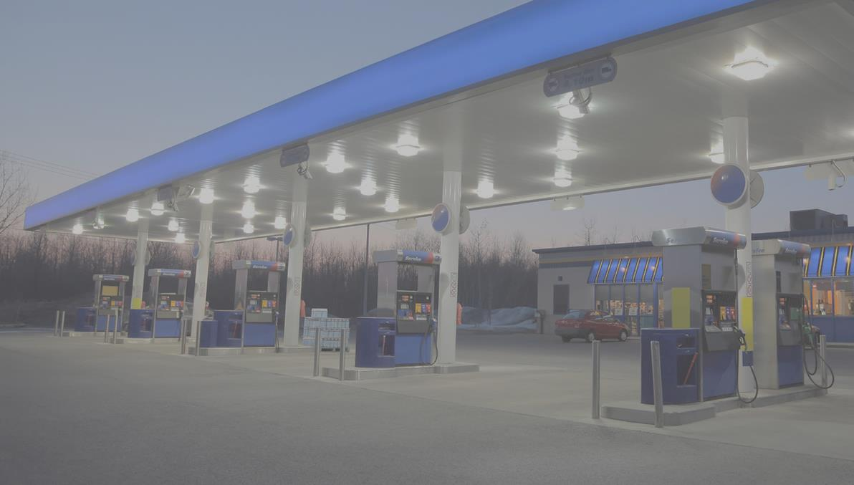
ITRC 3-Part Online Training Leads to YOUR Action
TODAY
Part 1:
Connect Science to LNAPL Site Management
(Section 3)
Part 2:
Build Your LNAPL Conceptual Site Model
(Sections 4 and 5)
Part 3:
Select / Implement LNAPL Remedies
(Section 6)
YOU
Apply knowledge at your LNAPL sites
Based on the ITRC LNAPL-3 Document: LNAPL Site Management: LCSM Evolution, Decision Process, and Remedial Technologies
Notes:
Our 3-part training series focuses on helping you:
Connect Science to LNAPL Site Management
Build your LNAPL Conceptual Site Model
*CLICK* Select/Implement LNAPL Remedies
After this training the expectation is that you will have the skills and knowledge to use the ITRC science-based resources improve decision making at your LNAPL sites.
Also, the sections from the document that are covered under each part of the training is provided on the slide.
Part 1: An Improved Understanding of LNAPL Behavior in the Subsurface - Connecting the Science to Managing Sites
- Explains how LNAPL behaves in the subsurface
- Examines what controls their behavior
- Explains what LNAPL data can tell you about the LNAPL and site conditions
Relevant and practical examples are used to illustrate key concepts
Part 1 explains how LNAPLs behave in the subsurface and examines what controls their behavior. Part 1 also explains what LNAPL data can tell you about the LNAPL and site conditions. Relevant and practical examples are used to illustrate key concepts.
Part 2: LNAPL Conceptual Site Models and Remedial Decision Framework - Do you know where the LNAPL is and how to address LNAPL concerns?
Addresses LNAPL conceptual site model (LCSM) development and the overall framework for making LNAPL remediation and management decisions
Discusses key LNAPL and site data
When and why those data may be important
How to effectively organize the data into an LCSM
Discusses how to resolve LNAPL concerns by selecting appropriate goals and objectives, choosing applicable technologies, and assigning remedial performance metrics and endpoints
Concludes with a special focus on LNAPL Transmissivity and how it may be used to improve LNAPL decision making
Part 2 addresses LNAPL conceptual site model (LCSM) development as well as the overall framework for making LNAPL remediation and management decisions. Part 2:
discusses key LNAPL and site data
when and why those data may be important, and
how to effectively organize the data into an LCSM.
Part 2 also discusses how to resolve LNAPL concerns by selecting appropriate goals and objectives, choosing applicable technologies, and assigning remedial performance metrics and endpoints. Part 2 concludes with a special focus on LNAPL Transmissivity and how it may be used to improve LNAPL decision making.
Part 3: Using LNAPL Science, the LCSM, and LNAPL Goals to Select an LNAPL Remedial Technology
Fosters informed remedial technology selection and appropriate technology application. Part 3:
Discusses remedial technology groups
Introduces specific remedial technologies
Provides a framework for technology selection
Introduces a series of tools to screen the several remedial technologies addressed in the updated ITRC document
A case study demonstrates the use of these tools for remedial technology selection, implementation, and demonstration of successful remediation
Part 3 of the training fosters informed remedial technology selection and appropriate technology application. Part 3:
discusses remedial technology groups,
introduces specific remedial technologies,
provides a framework for technology selection, and
introduces a series of tools to screen the several remedial technologies addressed in the updated ITRC document.
A case study demonstrates the use of these tools for remedial technology selection, implementation, and demonstration of successful remediation.

Slide 10
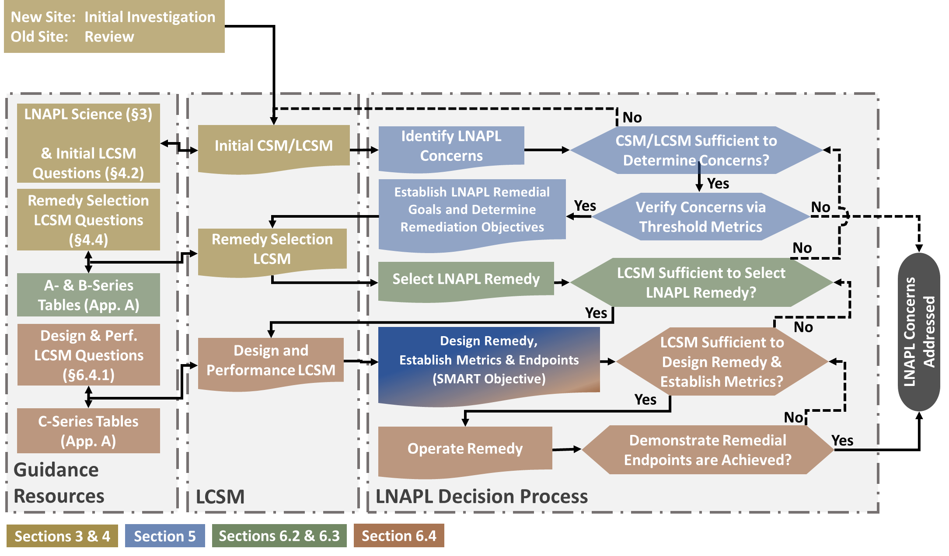



LNAPL Remediation Process and Evolution of the LCSM – Related to the Training Courses
Handout provided
ITRC LNAPL-3, Figure 1-1
Notes:
And, to link it back to the main framework flow chart from the document, here is Figure 1-1 and the associated content covered in each part of the training.

Slide 11
LNAPL Remediation Technology Groups
Learning Objective:
Understand:
  What the LNAPL remediation technology groups are,
  Why they’ve been grouped, and
  How site goals and objectives influence the selection of a technology group
Phase Change?
Technology Groups
Poll Question
Notes:
How many different LNAPL remedial technologies have you APPLIED/USED at your sites?
1-4
5-8
9-12
13-16
17 or more

Slide 12

Many Technologies Available
(ITRC LNAPL-3 Guidance Table 6.1)
21 LNAPL remedial technologies addressed:
Excavation
Skimming
Vacuum Enhanced Skimming
Total Liquid Extraction
Multi-Phase Extraction
Water/hot water flooding
Surfactant-enhanced subsurface remediation
Cosolvent flushing
Steam Injection
Thermal conduction heating
Electrical resistance heating
In-situ smoldering
Air sparging/ soil vapor extraction
Biosparging/bioventing
In-situ chemical oxidation
Enhanced anaerobic biodegradation
Natural source zone depletion
Activated carbon
Phytotechnology
Physical or hydraulic containment
In-situ soil mixing (stabilization)
Technology Groups
Key Point: Who ya gonna call?
Notes:
12
The LNAPL Technical and Regulatory Guidance includes 21 different remedial technologies.
These vary from the relatively simple and straightforward such as excavation
To more complex technologies such as electrical heating.
So how do you know what technology is appropriate for a particular site and objective?
12

Slide 13
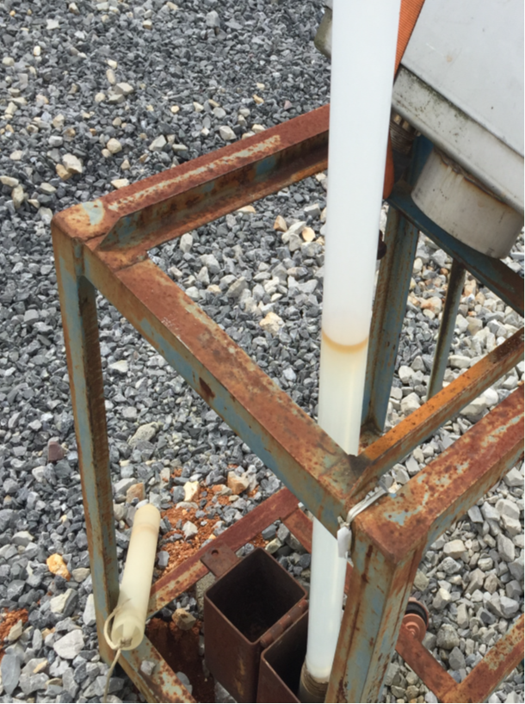
Not Included in Technology Tables
Manual Bailing
Absorbent Socks
Periodic or Short-term Vacuum Truck Events
Passive Skimmers
Technology Groups
Notes:
Less intensive LNAPL recovery technologies such as the use of adsorbent socks, manual bailing, passive skimmers, or (periodic, short-term) vacuum trucks are not included in the technology tables. These methods generally are not considered to be very effective to recover a significant amount of LNAPL. However, depending on local regulations, aesthetic concerns or emergency response action ( which are not covered in this document) they may very well end up being used at a site.

Slide 14
Guidance Technology Series Tables
Guidance Appendix A
A table series (Tables A, B, and C) for each of the 21 LNAPL remediation technologies
  A-series – general technology information
  B-series – evaluation factors
  C-series – technical implementation considerations
For a technology, the A, B, and C tables are presented on consecutive pages
Key literature references presented in the tables
Technology Groups
Key Point: Appendix A presents typical technology applicability to site conditions as concluded by the LNAPL Team. This doesn’t mean you can’t apply the technology in a setting different than what is presented.
Notes:
The A series table screens the technologies based on the geologic factors, the B series table will give specific impacts of nine factors for each technology, and the C series table is to determine minimum data requirements which soil permeability or determining LNAPL characteristics.
Technology descriptions in guidance are written for generalized conditions.
After considering your experience in terms of what you’ve learned here use experience with local geology and technology applications in the same area to augment the technology information in the LNAPL document.
Make sure you have confidence in the LCSM and it’s consistent with what you have learned.

Slide 15
Linkage Between Remedial Goals and Remedial Objectives
“Saturation Goal” – LNAPL mass recovery/control Objective
  Reduce LNAPL saturation by recovering LNAPL
  Stop LNAPL migration by containing LNAPL
“Composition Goal” – LNAPL phase change Objective
  Change LNAPL characteristics by phase change
“Aesthetic Goal” – LNAPL Saturation or Composition goals
Technology Groups
Notes:
15
The linkages between different remediation Goals and primary remediation objectives is summarized.
The saturation goal would be achieved by recovering or controlling LNAPL.
An example of recovery would be skimming which is a mass recovery technology. Containment which is a saturation based goal is achieved through LNAPL mass control technologies, a common example being a slurry wall.
A composition or concentration goal would be achieved primarily through phase change technology, an example being air sparging and soil vapor extraction.
Aesthetic goals can include both a saturation goal for LNAPL mass recovery/control or a composition goal and example being an odor based concern.
15

Slide 16

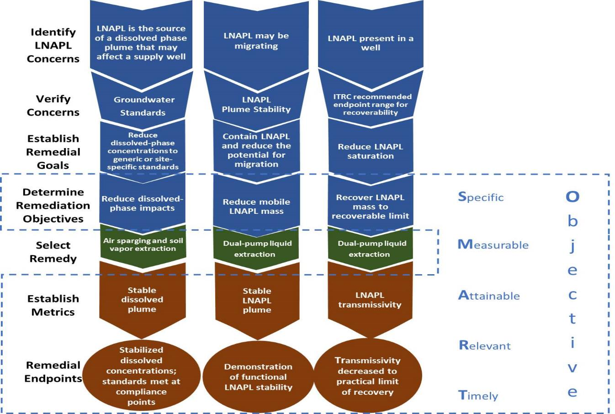
ITRC LNAPL-3, Figure 5-2
Technology Groups
Notes:
This was discussed in more detail in part 2 but I wanted to remind everyone that by following the LNAPL management process your objectives become SMART –Specific Measurable Attainable Relevant and Timely. As we continue to progress through this third training and end with a case study you will see how we continually circle back to define your objectives through the establishment of metrics and remedial endpoints. These SMART objectives are important especially in selecting a specific technology as your remedy.

Slide 17

Remedial Technology Groups
Phase Change
Mass Control
Mass Recovery
Phase Change
Technology Groups
Mass Recovery
Mass Control
Key Point: Simplify the selection of technology
Notes:
This slide shows the first cut of how to think about technologies and what they do. In the LNAPL document, this is also referred to as the “primary mechanism” in section 5 of the document by which LNAPL remediation takes place.
In addition to the primary mechanism, most technologies also act in other ways. These “multiple actions” of a technology can be simply represented by the ternary diagram. The dot in the ternary diagram shows where the technology fits in the remedial tech groups.
Clicks notice the dot is in the mass control corner of the ternary diagram click.

Slide 18
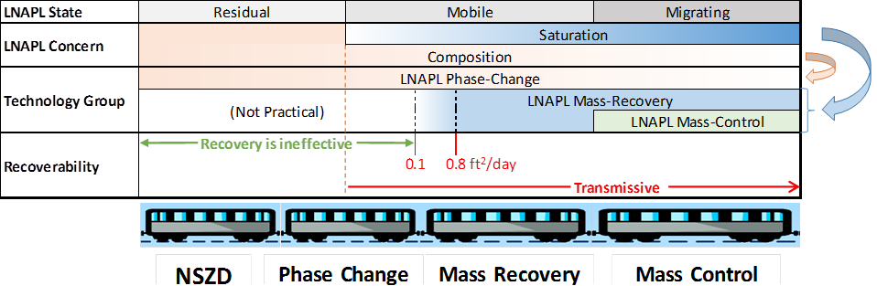


The Name Game & General Technology Group Applicability
ITRC LNAPL-3, Figure 5-3
Notes:
Mass Control and Mass Recovery is only used when LNAPL saturation is greater than residual:
- Mass control is used when there is an LNAPL migration risk – So in very high saturation conditions
- Mass recovery is used when LNAPL is mobile and practicably recoverable - > Sr
When LNAPL is less than saturation, only phase change technologies will work. Phase change technologies can also be applied to mobile and even migrating LNAPL.
Also the recoverability is represented here by the transmissivity number and as you can see mass recovery is ineffective below .1 ft2/day

Slide 19


Sequenced Technology Deployment - “Treatment Train”
4. Natural Source Zone Depletion
3. Phase Change
2. Mass Recovery
1. Mass Control
ITRC LNAPL-3, Figure 5-3
Notes:
When selecting technologies consider multiple treatment technologies or treatment trains. For example, you may begin with a slurry wall (click) to control the migration of the LNAPL and then move to dual pump liquid extraction (click) to recover mobile LNAPL. Air sparging and soil vapor extraction (click) may then be used to further remove LNAPL mass and potentially address vapor and groundwater risks, notice we are on the phase chance train car. The final treatment technology may be natural source zone depletion (click).

Slide 20

Treatment Trains
Good
When planned with SMART objectives, metrics for transition, and endpoints
Orderly implementation
Bad
Unplanned, lack specific SMART objectives, metrics for transition, and endpoints
“Throwing” more technologies at the problem
Technology Groups
Notes:
20
You want to have the right tool for the job. A Phillips head screw driver works fine but not for a flat head screw.
20

Slide 21

LNAPL Aesthetic (or combination)
Technology Groups
ITRC LNAPL-3, Figure S-1
Notes:
Aesthetic concerns such as odors, stains or sheens maybe an LNAPL concern that has to be taken into account. Ask yourself a few questions.
Are non-risk odors or surficial stains from the LNAPL a potential nuisance?
Is stakeholder perception of the occurrence of LNAPL a concern?
Not all LNAPL concerns will need remediation, therefore not all LNAPL concerns will generate LNAPL remedial goals and objectives.

Slide 22
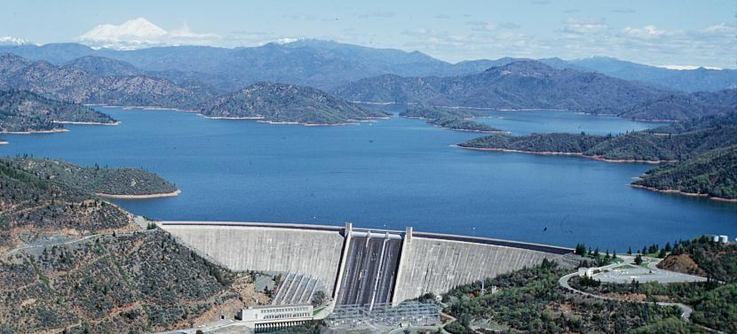
LNAPL Mass Control
Dam the LNAPL!
LNAPL Mass Control Concept
PC
MR
MC
Notes:
Let’s dive a little deeper into the categories of remedial technologies.
When you have excess saturation as a remedial goal and are concerned about migration
LNAPL Mass Control technologies may be used. These technologies function by blocking the effects of the LNAPL from reaching somewhere else. Like a dam across a river holds back the water.
Note the ternary diagram in the lower right. The dot is placed at the Mass Control (MC) corner.

Slide 23



Saturation Goal
LNAPL Remedial Goal
LNAPL Concern
Remediation
Objective
Stop LNAPL migration by physical barrier
Terminate LNAPL body migration
Migration
LNAPL Mass Control Concept
Key Point: Limit mobility or eliminate migration through physical barriers (binding or containment)
Notes:
23
This slide links concerns, goals, and objectives. The LNAPL concern here is migration which is linked to a saturation-based goal which is to terminate the LNAPL body migration and reduce the potential for LNAPL migration and then linking that goal to a remediation objective which is to stop LNAPL with a physical barrier. This migration concern can be addressed by a Mass Control technology.
23

Slide 24
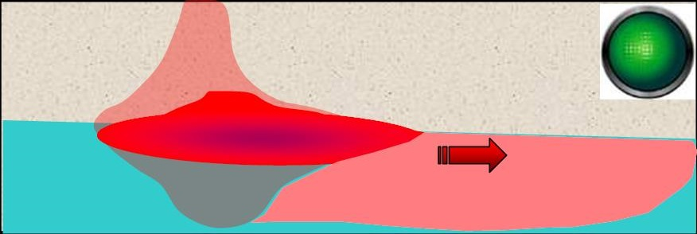


Think Barriers
Uncontrolled
LNAPL Mass Control Concept
PC
Controlled
MR
MC
Key Point: Mass control technologies block LNAPL from affecting the surrounding soil, groundwater and/or surface
Notes:
In the top panel, you can see the uncontrolled migration of LNAPL away from the point of initial release and highest LNAPL saturation.
Think of this type of technology as containing LNAPL migration due to high saturation.
In the bottom panel, you can see that these effects can be mitigated by putting a barrier across the path of LNAPL migration. This is mass control. LNAPL is not removed, just controlled in place. An example of this type of mass control technology is a slurry wall.

Slide 25
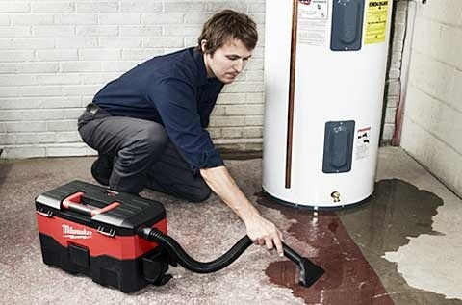
LNAPL Mass Recovery
LNAPL Mass Recovery Concept
PC
Think removal as bulk liquid…
MR
MC
Notes:
25
The next category of remedial technologies to describe is LNAPL Mass Recovery.
A conceptual example is vacuuming up a spill. In this example, water is being removed (recovered) from the footprint of the spill.
This is a good analogy for mass recovery. Will the shop vac get all the water up? No, but it will remove enough to keep it from spreading further. The shop vac would recover less of the spilled water if the floor was carpet (finer-grained soil) instead of concrete (coarser-grained soil). Recovery will also allow for faster natural drying so the life cycle of the spill is reduced.
Note that on the ternary diagram the dot is now in the Mass Recovery (MC) corner.
25

Slide 26
Saturation Goal
LNAPL Remedial Goal
LNAPL Concern
Remediation
Objective
Reduce LNAPL when above residual range
Recover LNAPL to Maximum Extent Practicable
LNAPL occurrence in wells
LNAPL Mass Recovery Concept
Key Point: Reduce mobility and potential for migration by changing LNAPL saturation through mass recovery
Notes:
26
This slide links the LNAPL concern of LNAPL occurrence in wells to a saturation-based goal of reducing LNAPL when LNAPL is above the residual range and the remediation objective of recovering LNAPL to the maximum extent practicable.
You can achieve this goal by recovering enough LNAPL to reduce LNAPL saturation, mobility, and gradient. This concern, goal, and objective would be addressed through the mass recovery technology group.
26

Slide 27

LNAPL Phase Change
LNAPL Phase Change
PC
MR
MC
Notes:
27
No it’s not time for a coffee break, it’s time for a phase change.
Note dot on ternary diagram is at the Phase Change (PC) corner
27

Slide 28



Composition Goal
LNAPL Remedial Goal
LNAPL Concern
Remediation
Objective
Deplete volatile or soluble constituent concentration in LNAPL
Risk via Vapor Intrusion
Reduce concentrations
LNAPL Phase Change
Key Point: Reduce soil vapor or groundwater risk by removing risk-driving constituent(s) from LNAPL
Notes:
28
The LNAPL concern here is risk of petroleum vapor intrusion overlying an LNAPL source. This is a compositional based goal to reduce the constituent concentrations in soil vapor and/or the dissolved phase from an LNAPL source. The remediation objective would then be to abate the unacceptable vapor accumulation by depleting the volatile constituents in LNAPL. This concern, goal, and remediation objective would then be addressed by a technology in the phase change group.
28

Slide 29

LNAPL Composition
Modified by increasing rates of volatilization and dissolution from LNAPL body – phase change from liquid to vapor phase or liquid to dissolved phase
Example technologies
  Soil vapor extraction,
  or in combination:
    Air sparging
    Heating
    Steam injection
  Enhanced aerobic biodegradation
  Enhanced anaerobic biodegradation
  In-situ chemical oxidation
LNAPL Phase Change
Notes:
How does phase change modify the LNAPL composition
increases rate of volatilization
Increases rate of dissolution
Vapor technologies, increase the vapor gradient between LNAPL and the native environment, increase the rate of volatilization out of the LNAPL and changing the LNAPL composition to a low volatile content. These technologies may leave LNAPL in place, but can reduce or eliminate other pathway concerns such as explosive vapor accumulations, inhalation of toxic vapors, or ingestion of dissolved compounds.
For example steam injection, increases the volatility, changing the composition by reducing the composition of the volatile fraction of the LNAPL composition.

Slide 30
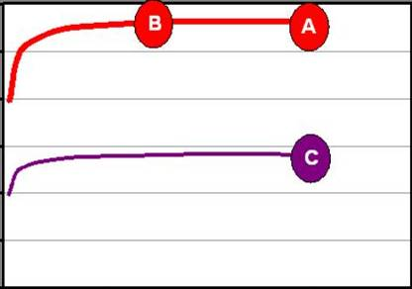

Contrast Between Composition And Saturation Goals
12
8
4
0
Reduces
Persistence
Reduced saturation (less LNAPL)
Reduces Concentration
Benzene
Equilibrium Groundwater Concentration (mg/L)
Saturation vs Composition
Changed composition
0 0.2 0.4
LNAPL Saturation
ITRC LNAPL-3, Figure 3-5
Key Point: Abatement of dissolved or vapor concentration is dependent on change in composition (mole fraction) and not saturation (unless almost all LNAPL is removed)
Notes:
Why is composition change important? It is a more effective way to target constituents of concern that are a small fraction of the total LNAPL, for example, benzene is just one of many hydrocarbons that makes up gasoline, but in many cases it’s the only component driving risk. So using a phase change technology to reduce the benzene concentration in the gasoline (A to C) is going to be more effective than recovering some, but not all, of the bulk gasoline (A to B).
The composition and saturation goals are conceptually compared. The first scenario from A to B shows how a 50% reduction in saturation has little effect on the dissolved benzene concentration. In contrast a 50% reduction in the mole fraction of benzene from A to C has a corresponding 50% reduction in benzene concentration. The key point is that the dissolved benzene concentration is dependent on the change in composition and mole fraction. Research has shown that a reduction in saturation has little affect on the dissolved concentration unless almost all the LNAPL from a source zone is removed (e.g., see API LNAST model, publications by David Huntley)
30

Slide 31
Knowledge Check
What are the three technology groups?
Unconfined, Perched, and Confined
Mass Control, Mass Recovery, and Phase Change
Air Sparging, Skimming, and Excavation
Aesthetics, Saturation, and Composition
Notes:
No associated notes.

Slide 32
Technology Groups Overview
Takeaways
Select your Remedial Goals - Saturation or Composition based
Determine your Remedial Objectives (vapor abatement, remove mobile LNAPL)
Select your technology from the 3 technology groups
The 3 groups are:
  Mass Control
  Mass Recovery
  Phase Change
Sequence your technology deployment and use the “treatment train”
Technology Groups
Notes:
No associated notes.

Slide 33
Natural Source Zone Depletion
Mass Control
Mass Recovery
Phase Change
  NSZD
Notes:
“Thanks. Let’s spend a little additional time on the NSZD remedial technology, dive into the understanding of NSZD, and how to estimate its rates.”
It is an important part of most LCSMs and LNAPL remedial technology evaluations.
It is also of significance because engineered remedial actions typically do not always completely remediate soils and NSZD may be useful to address the residual hydrocarbon.
Initial Poll: Starting Knowledge Level
Have you measured NSZD rates and incorporated into it into your LCSM and/or
used NSZD for remediation decision making?
Yes
No
Quick poll to assess our collective starting knowledge position.
To reiterate what was said about NSZD – “People want to know more about NSZD, it has its own appendix, and people are still learning about NSZD. Also, NSZD is not like the other techs because it’s already happening (at some rate) and my opinion is you can’t fully develop a remedial strategy unless you understand the natural processes at your site.”
Note that the discussion will include a summary of old (ITRC, 2009) and new information that is presented on NSZD. LNAPL-1 was really only about the saturated zone and soil gas profiling and the gradient method; new methods have emerged. Detailed new information on NSZD is presented in Appendix B of LNAPL-3.

Slide 34
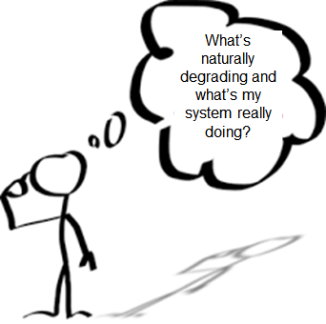
NSZD Learning Objectives
NSZD processes and importance
  It occurs subsurface at most sites and results in LNAPL mass losses
Incorporate natural source zone depletion (NSZD) into your LCSM
  There are various measurement methods to suit varied site conditions
Consider NSZD as a remediation alternative
  It is an effective, accepted, and sustainable option for low risk sites
Natural Source Zone Depletion
Notes:
First, we’ll cover the details of LNAPL biodegradation
Next we’ll discuss NSZD as a component of the LCSM
Initial - natural degradation processes, stability
Remedy selection - phase change technology option
Design and performance - rate used as a performance metric
Finally, NSZD is a remedial technology option and is of significance because it occupies a position in the spectrum of remediation options that can be used as a basis for comparing the performance and relative benefit of other remediation options.
It is a phase change technology – addresses composition and saturation objectives. It can be used as a stand-alone technology or and option for treatment train transition.
NSZD is applicable to risk-based closure and low threat sites, and long-term management.

Slide 35
Conceptualization of NSZD
Natural Source Zone Depletion
(with permission from API, 2017, http://www.techstreet.com/standards/api-publ-4784?product_id=1984357)
LNAPL-3, Appendix B, Section 2
Notes:
New conceptualization from prior monitored natural attenuation (MNA)-based version that focused on saturated zone and aqueous manifestations of NSZD. This is all about the LNAPL source zone, an extension of dissolved phase MNA.
NSZD is biodegradation throughout the source zone – saturated and vadose. At many sites, it is typically about the residual LNAPL mass that is left behind in the saturated zone
Methanogenesis typically dominates
Produces significant gases that are transported into the vadose zone
The gaseous expression can be used to estimate mass losses
Vapor-based losses >> aqueous-based losses (at most sites)
Key Elements of LCSM for NSZD:
Ambient temperature clime - warmer temperatures, higher NSZD rates
Soil type and moisture - fine-grained, high-moisture limit NSZD
Ground cover and permeability - impervious ground cover may results in methane in shallow soil gas
LNAPL distribution (unconfined, confined, or perched) - effects bio processes and gas expression patterns
WRT to concerns with distances to nearby structures, if NSZD is to used as a remedial strategy, then see Figure 3-5 of the ITRC Petroleum Vapor Intrusion (PVI) guidance (2014).

Slide 36
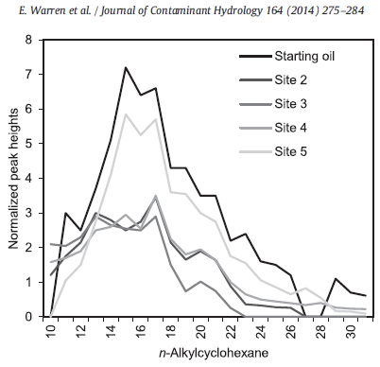
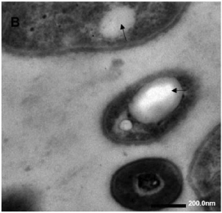
Key Aspects of NSZD
Rates are a bulk measure
  Appear to be zero-order
  (constant)
Direct biodegradation
  Oil-contact microbiology
  Observing significant losses
  of longer chain compounds
Natural Source Zone Depletion
(Warren et. al., 2014)
Pseudomonas
Intracellular n-octadecane inclusions
(Transmission electron microscopy from Hua et. al., 2014)
Notes:
As measured, NSZD rates are in units of total petroleum hydrocarbons (TPH), not chemical-specific (yet). Granted, while the knowledge of the science is still young, we see little change in rates over time. Of note, estimation of remedial timeframe via NSZD are a work-in-progress, new models are being developed to update the fundamentals and improve predictions.
The biodegradation processes of NSZD do not reduce LNAPL mass solely via dissolution into the aqueous phase. LNAPL mass may also be depleted by direct oil contact biodegradation. This is a significant improvement in understanding of NSZD.
Direct-contact biodegradation occurs within the pores in the immediate proximity to the LNAPL. The image (bottom-left) shows LNAPL inclusion into bacteria cells via microscope. By-product gases from this reaction are directly outgassed to the vadose zone.
The net effect of the NSZD processes is degradation of all hydrocarbons in the LNAPL, not just the short chain or more soluble components. In fact, at Bemidji, as shown on the figure, they saw more significant degradation of longer-chain compounds.

Slide 37
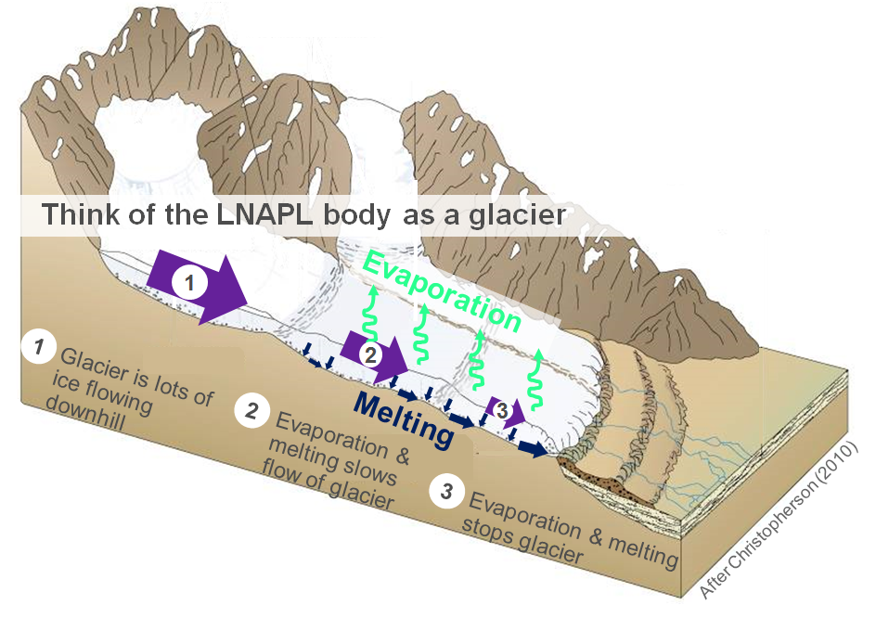
Using NSZD for Decision Making
LNAPL body stability evaluation
Natural Source Zone Depletion
LNAPL-3, Appendix B, Section 5.3
Notes:
Think of LNAPL body as a glacier. Processes of melting and evaporation are analogous to NSZD; they are loss mechanisms acting on the body. Where losses exceed rates of glacier (or LNAPL) advance, recession results. This explains the common observation of monitoring wells without in-well LNAPL installed in boreholes with stained soil beyond the leading edge of the LNAPL. This is direct evidence of the former presence of the LNAPL body at this location, and occurrence of NSZD which has reduced the LNAPL saturation to a residual/stained condition. These processes are on-going, and at sites without an on-going release, will ultimately lead to the “residualization” of the entire body.

Slide 38
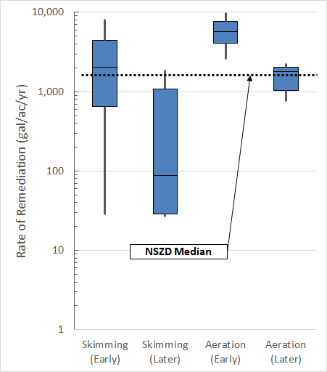
Using NSZD for Decision Making
Practicability of recovery
Endpoint metric for active
LNAPL remediation
Benchmark for enhanced-
NSZD remedy design
  Aeration
  Enhanced anaerobic
  Heating
Natural Source Zone Depletion
(Median NSZD rate from Garg et al., 2017. System data modified from Palaia, T. 2016. Natural source zone depletion rate assessment. Applied NAPL Science Review 6.)
LNAPL-3, Appendix B, Section 5.3
Notes:
Garg et al., 2017 – “…the overall sitewide averages…, with the middle 50% of sites falling between 700 and 2800 gallons/acre/year for the 25 sites, giving a representative median NSZD rate of about 1700 gallons/acre/year.”
Palaia, 2016 – “…included active remediation mass removal rate data from 29 different systems ranging from LNAPL skimming to multiphase extraction [at various diverse sites].”
It should be noted that implementation of active remediation via aeration changes the subsurface conditions significantly and disrupts NSZD as we’ve described it (i.e., methanogenic). As shown on the figure, a transition to aerobic conditions can enhance mass losses over NSZD. Other technologies, such as LNAPL skimming would not and in this case, NSZD mass losses would be additive to those from skimming. It’s important to account for this.

Slide 39
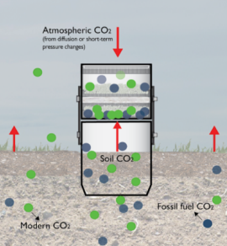
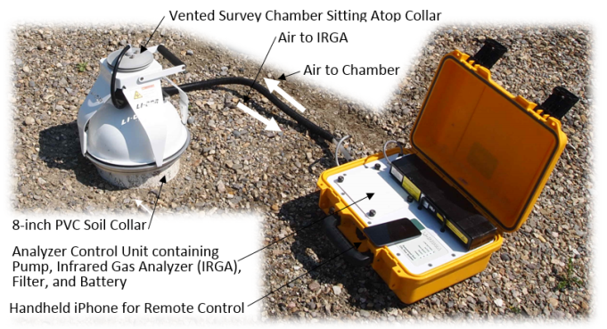
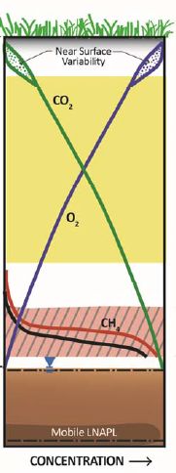
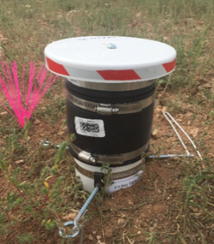
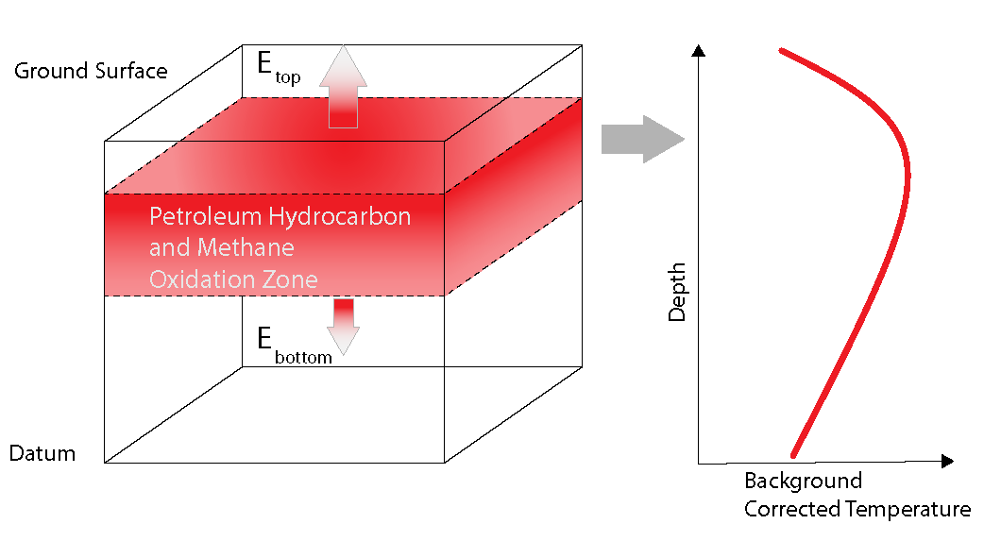
Four Methods to Measure NSZD
2. Passive Flux Trap
3. Dynamic Closed Chamber
1. Gradient Method
Natural Source Zone Depletion
(from API, 2017,
http://www.techstreet.com/standards/api-publ-4784?product_id=1984357)
4. Biogenic Heat
CO₂ EFFLUX
(from E-Flux, LLC, 2017, http://soilgasflux.com/main/home.php)
(from API, 2017,
http://www.techstreet.com/standards/api-publ-4784?product_id=1984357)
Notes:
Measurement method details (how-to) are provided in the LNAPL-3 guidance Appendix B, Sections 4.1 through 4.4.
Important note before closing the methods discussion, as with any environmental monitoring, QA/QC is important –
Background correction
Use ¹⁴C for best accuracy
Standard means:
Calibrate field instruments
Field and/or trip blanks
Duplicates - results can be variable
Measurement confirmation with added method

Slide 40
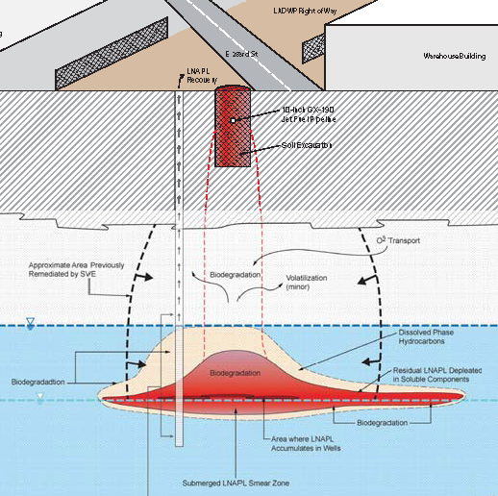
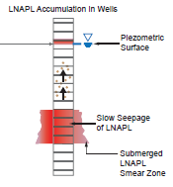
Case Study - Transition from LNAPL Fluid Recovery to NSZD
Right of Way
Jet fuel pipeline release
Silt and clay overly silty,
fine-grained sand
Submerged LNAPL
Historical remedial actions
  Partial source excavation
  LNAPL skimming
    10,000 gals removed
    (~10 yrs), <100 gallons/yr
  SVE system
    9,600 gallons removed (~5 yrs)
Street
Building
LNAPL recovery
10” pipeline (release)
Soil excavation
O₂ Transport
SVE treatment limits
Biodegradation
Volatilization
Natural Source Zone Depletion
Dissolved-phase hydrocarbons
Biodegradation
Biodegradation
Residual LNAPL
Biodegradation
Mobile LNAPL
Submerged LNAPL source zone
LNAPL-3, Appendix B, Section 5.3.1
Notes:
Case study to demonstrate that many remedial technologies will progress to relatively low mass removal rates that are insignificant; continued operation will not provide commensurate value in terms of increased environmental protection and/or risk reduction. The practical endpoint of the engineered mass removal technology will have been achieved.
This is the appropriate point for transition. Here is a case study to help demonstrate how to use NSZD for site remediation decision making. Here are the steps you might take to move from inefficient active remedy to NSZD. As detailed in LNAPL-3, Appendix B, it includes use of a multiple lines-of-evidence approach to support the transition decision.
WRT to concerns with distances to nearby structures, if NSZD is to used as a remedial strategy, then see Figure 3-5 of the ITRC PVI guidance (2014).

Slide 41
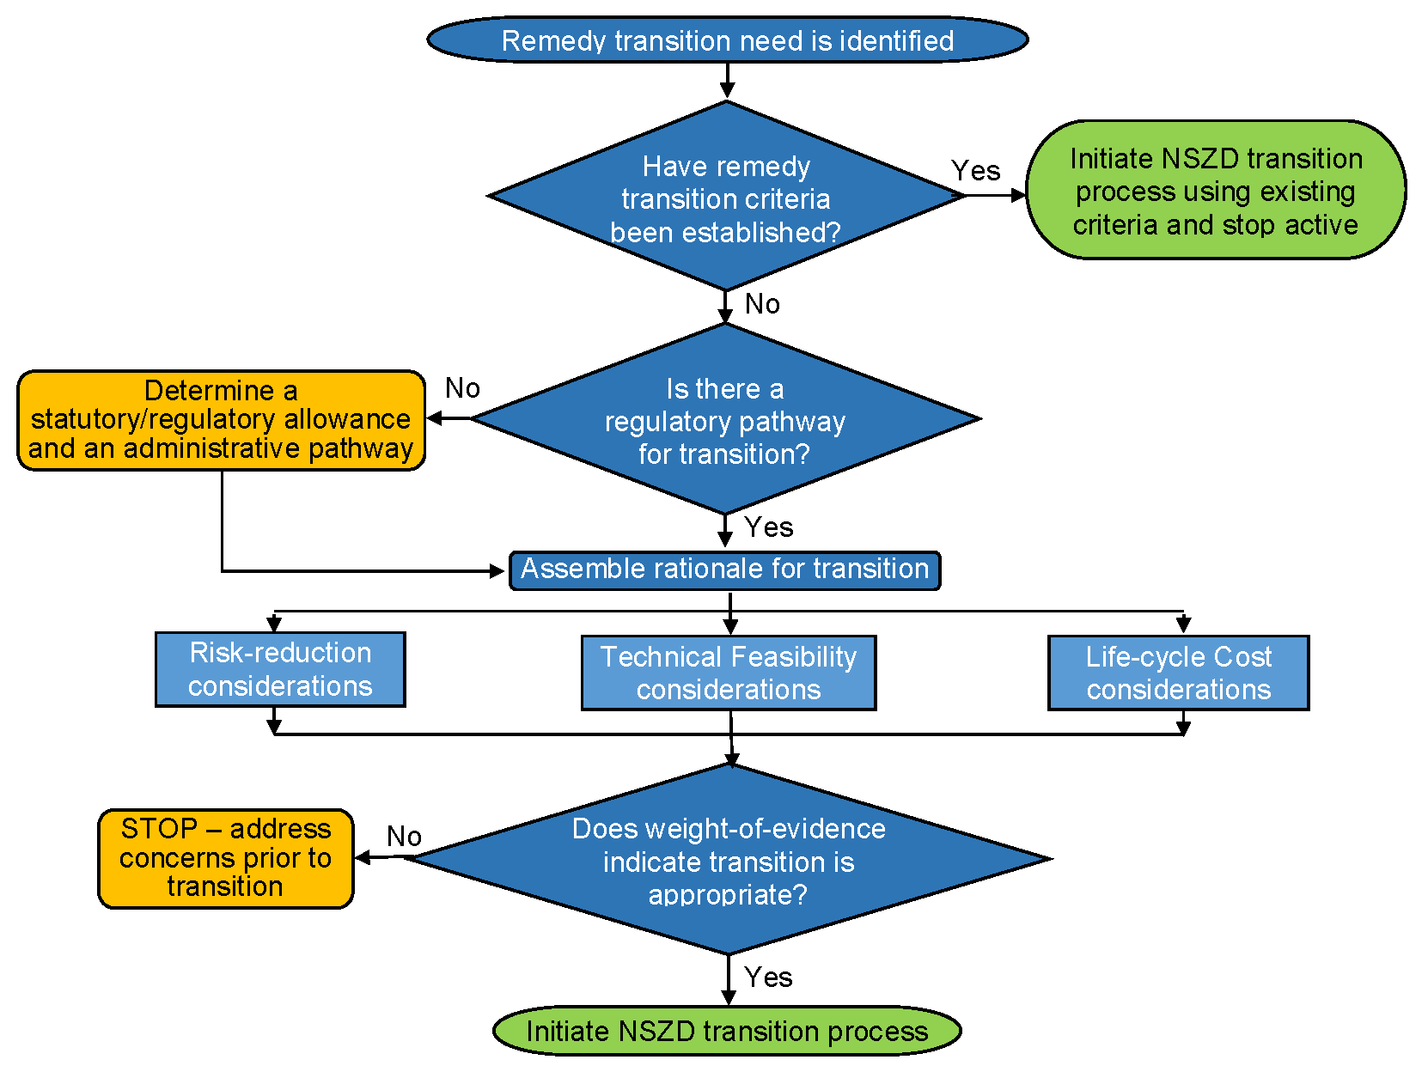
Transition Decision Logic
Compile lines-of-evidence to form basis of decision
Natural Source Zone Depletion
LNAPL-3, Appendix B, Figure NSZD-15
Notes:
Define a regulatory pathway first
Note the multiple lines-of-evidence approach - practice has evolved to use multiple lines-of-evidence to justify transition. For example, the (NRC 2013) proposes taking:
risk reduction,
life-cycle costs, and
technical feasibility
into account during a transition process that is transparent, reduces long-term risks to an acceptable level, and is practical and cost effective. Based on these considerations, transition to NSZD as the final remediation component will merit consideration at many sites

Slide 42
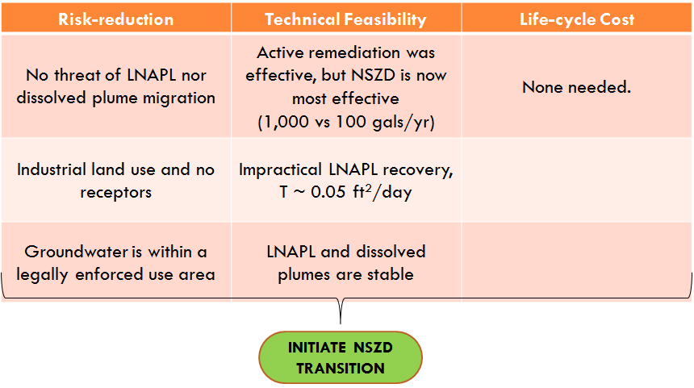
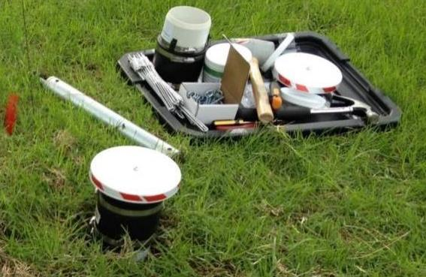
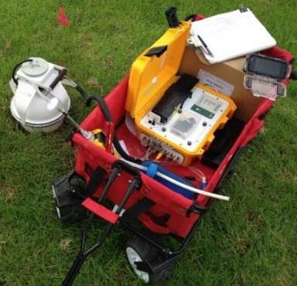

Case Study – Decision Logic to NSZD
Passive Flux Trap Method Use
Chamber Method Use
Notes:
Using a multiple lines-of-evidence approach:
LNAPL and dissolved phase plumes are stable
Land use is industrial, within a utility R.O.W.
Non-potable aquifer and groundwater rights are strictly legally controlled
Nearest use for refinery process, municipal supply ½ mile upgradient, 300-ft deeper
No current or future unacceptable exposure risk
No indoor or ambient health risks identified
Biogeochemical mass budgeting shows 9-12 gallons per year of LNAPL depletion. CO₂ efflux monitoring showed an additional 700-1,300 gallons per year of LNAPL mass losses via NSZD.
Evaluation results were presented to the regulatory agency and the agency agreed. Remedial action transitions to NSZD with annual monitoring using the biogenic heat method.
Emphasize: NSZD is not a walk-away technology – alike MNA, monitoring will be performed and often include contingency to provide an appropriate level of protectiveness and ensure NSZD remedy performance. If the performance of NSZD is not adequate, and the monitoring data indicates that the remedy fails to meet one of the performance metrics, then the remedy must be adjusted or optimized to achieve remedial goals. (ITRC 2006) prescribes decision logic for optimization and contingency planning to achieve the stated performance monitoring objectives.

Slide 43

NSZD - Summary
Natural source zone depletion (NSZD) occurs subsurface at most sites
  Changes LNAPL composition and reduces saturation
  Incorporate it into your LCSM
There are various measurement methods to
suit varied site conditions
It is an effective, accepted, and
sustainable option for low risk sites
It is a viable remedial alternative
as a stand-alone or transition
remedy
What’s naturally degrading and what’s my system really doing?
Notes:
Exit Poll: NSZD Data Use
Why is it important to understand NSZD at a petroleum remediation site?
Key fundamental component of the LCSM
Establish a benchmark for remedial decision making
Support system optimization of active systems
All of the above
-----------------------------------------------------
NSZD biodegrades LNAPL. Within the ITRC remedial decision making framework presented in this training, it is a phase change technology – addresses both composition and saturation objectives.
NSZD is a valuable component of the LCSM:
Initial - natural degradation processes, stability
Remedy selection - phase change technology option
Design and performance - rate used as a performance metric
Four different methods are available to measure the rates of NSZD at your site. Selection depends on site conditions and data objectives.
NSZD is applicable to risk-based closure and low threat sites, and long-term management. It can be used as a stand-alone technology or and option for treatment train transition
“Now I’ll turn it over to Lloyd Dunlap of TriHydro Corporation to describe the plethora of additional remedial technologies available to address LNAPL concerns. Lloyd……”

Slide 44
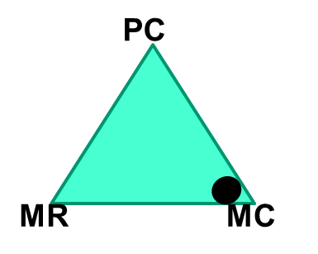
LNAPL Remedial Technology
Groups
Mass Control - Contain LNAPL at a defined boundary (e.g. to protect a receptor)
Mass Recovery - Abate LNAPL body migration / mobility by removal of LNAPL mass
Phase Change - Abate unacceptable contaminants emanating from the LNAPL source
LNAPL Remedial Technologies
Technologies (i.e. processes) sometimes overlap into two groups.
Notes:
As was mentioned earlier, technologies are broadly grouped in the document by how they address LNAPL concerns. We use this triangular diagram to help identify how a technology can address a concern.
For example, if LNAPL migration is a concern, Mass Control technologies are probably your first group of technologies to look at. Your GOAL could be to “contain LNAPL at a defined boundary”. If LNAPL saturation is a concern, focus on Mass Recovery technologies. Your GOAL could be “abate LNAPL migration by removal of LNAPL mass. And if you have LNAPL residual/compositional effects, then focus on Phase Change technologies. Your GOAL could be “Abate contaminants emanating from the LNAPL source”.
Technology groupings can overlap. This means some technologies can serve within more than one group. This is good, because they can address several LNAPL states at one time. Technologies that don’t overlap may be useful in treatment trains or in combination with other technologies to enhance or accelerate cleanup.
As Justin discussed, we can use these technologies as a treatment train, or even combine them together.

Slide 45
21 Technologies (2018) –
Name Change and Added
Excavation
Skimming
Vacuum enhanced skimming (LNAPL & vapor)
Total liquid extraction (LNAPL & water)
Multi-phase extraction (LNAPL, water, & vapor)
Water/hot water flooding
Surfactant-enhanced subsurface remediation
Cosolvent flushing
Steam injection
Electrical resistance heating
Air sparging/soil vapor extraction (AS/SVE)
In-situ chemical oxidation
Natural source zone depletion (NSZD)
Physical or hydraulic containment
In-situ soil mixing (stabilization)
Thermal conduction heating
In-situ smoldering
Biosparging/bioventing
Enhanced anaerobic biodegradation
Activated carbon
Phytotechnology
LNAPL Remedial Technologies
Notes:
Six new technologies were added (green) in today’s guidance. Four technologies in blue had their name changed. These are now the technologies we have in today’s guidance document. I am going to talk more about these added technologies a bit later on.

Slide 46
Remedial Objective Grouping & Overlap
Phase Change
Biosparge/Biovent
NSZD
ISCO
Enhanced Anaerobic Degradation
AS/SVE
Vacuum Enhanced Skimming
Cosolvent Flushing
Electric Heat
Thermal Heat
Phytotechnology
Activated Carbon
MPE
Mass Recovery
Skimming
Excavation
SESR
Water flood
Mass Control
Physical or Hydraulic Containment;
In Situ Soil Mixing
Total Liquid
Extraction
Notes:
Here is another way to list the technologies within their groups of Phase Change on the top, Mass Control on the right and Mass Recovery on the lower left. As we said some technologies fit within more than one group. An example is Phytotechnology and activated carbon with can fit within both Phase Change and Mass Control.

Slide 47
LNAPL Remedial Technology Groups
Mass Control – examples of Goals
  Contain LNAPL at a defined boundary
Mass Recovery
Phase Change
LNAPL Remedial Technologies
Notes:
We are first going to talk about Mass Control technologies. Mass Control technologies typically “contains” LNAPL at a defined boundary.

Slide 48
Mass Control Technologies
Physical containment or Hydraulic containment
  Sheet piles
  French drain
  Slurry wall
  Groundwater extraction
  Trenches
  Permeable absorptive barrier
In situ soil mixing (stabilization)
  Also: Phytotechnology, Activated Carbon, Total Liquid Extraction
Refer to Tables 6.1, 6.2, 6.3 & Appendix A
LNAPL Mass Control
PC
MR
MC
Notes:
Mass Control technologies are typically physical containment or hydraulic containment. You can see some examples here that you likely recognize. Another Mass Control technology is In Situ soil mixing, or stabilization. But other technologies that can be used as Mass Control are listed here also.
We will refer to the ternary diagram on the lower right to demonstrate what remedial objectives are being used for each technology. The dot in the lower right shows the remedial objective is MC or Mass Control.
To learn more about these technologies, refer to Tables 6.1, 6.2, 6.3 and appendix A.

Slide 49
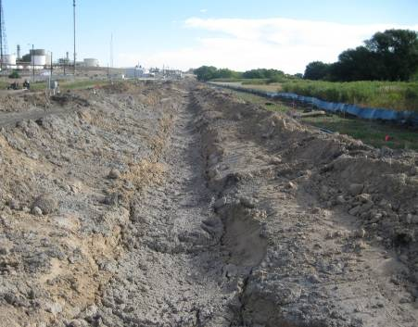
Performance Metrics for Mass Control Technologies
See Tables 5.2 and 6.3 for additional metrics
No first LNAPL occurrence in down gradient sentinel well
LNAPL body footprint stabilized based on long-term monitoring (quarterly, semi-annual, annual monitoring)
Photo of barrier wall
LNAPL Mass Control
Notes:
Here are some example performance metrics for Mass Control Technologies:
You do not detect LNAPL in a downgradient well, or the LNAPL body has stabilized.
Other metrics are found in Tables 5.2 and 6.3.

Slide 50



Example: A LNAPL Plume is migrating toward a river
Guidance Document
Concern
LNAPL migrating into a river
Table 5.1
Saturation based
Stop the LNAPL migration
Goal
Table 5.1
Remedy Selection LCSM
Review or Update the LCSM to Select a Remedy
Section 4.4
Notes:
Here is an example of how to select a technology. Let’s say you have a site where LNAPL is migrating toward a river. From the process we learned in Session 2, our CONCERN can be labeled as LNAPL migrating into a river. This process is found in Table 5.1 of the Guidance Document. Our GOAL is LNAPL saturation based, we want to stop the LNAPL migration. We use the Remedy LCSM to review or update the LCSM to select a remedy. What might you need to know? There may be other considerations that influence the LNAPL conceptual site model and remedy selection, such as results of testing or modeling, or other factors, including cost and liability concerns. More about this is found in Section 4.4.

Slide 51



Example continued: A LNAPL Plume is migrating toward a river
Guidance Document
Table 5.1 Sections
5.3 & 5.6
“SMART”
Objective
Stop the migration using physical barrier
Mass Control needed
List of technologies
  Physical or hydraulic containment
  In Situ soil mixing
  Also:
    Total liquid extraction
    Phytotechnology
    MPE
Align with the site conditions
Further technology details needed
Group of Technologies
Table 5.1
Table 6.3
Appendix A
Notes:
Our SMART OBJECTIVE is to use a physical barrier to stop the migration. A “SMART” objective is (Specific, Measurable, Attainable, Relevant and Timely). More about this can be found in Table 5.1 and Sections 5.3 and 5.6
We select a Technology Group that provides Mass Control. The list of technologies within Mass Control are physical or hydraulic containment; other technologies are listed also. You next align your technology with the site conditions using Table 6.3. Appendix A gives you more details about the technology.

Slide 52

Example continued: A LNAPL Plume is migrating toward a river
Guidance Document
Design and engineer the technology to meet Goals
Evaluate Performance and Set Metrics
Design &
Performance
LCSM
Table 6.3
Section 6.4.1
No first LNAPL occurrence in down gradient well
LNAPL body footprint stabilized
No sheens detected in river
Example
Performance
Metrics
Tables
5.2 & 6.3
Notes:
We then go to the Design and Performance LCSM. We design and engineer the technology to meet the goals. Then we evaluate the performance and set metrics. Some SMART metrics for this example could be
No first LNAPL occurrence in down gradient well or
No sheens detected in river
Other metrics can be found in the Guidance Document in Tables 5.2 and 6.3.
Justin and Joanne will outline a case study in a few minutes that will give further details on these concepts.

Slide 53
Remedial Objective Grouping & Overlap
Phase Change
Biosparge/Biovent
NSZD
ISCO
Enhanced Anaerobic Degradation
AS/SVE
Vacuum Enhanced Skimming
Cosolvent Flushing
Electric Heat
Thermal Heat
Phytotechnology
Activated Carbon
MPE
Mass Recovery
Skimming
Excavation
SESR
Water flood
Mass Control
Physical or Hydraulic Containment;
In Situ Soil Mixing
Total Liquid
Extraction
Notes:
We will next talk about Mass Recovery technologies. The most familiar technologies to you are likely skimming, excavation, SESR or water flooding. But as you can see some technologies like Total Liquid Extraction are both Mass Recovery and Mass Control.

Slide 54
LNAPL Remedial Technology Groups
Mass Control
Mass Recovery
  Examples of SMART Objectives
    Recover LNAPL to a practicable limit
    LNAPL transmissivity
Phase Change
LNAPL Mass Recovery
Notes:
Here are two examples of a Mass Recovery SMART objective. With Mass Recovery, we “recover” the LNAPL body migration by removal of the LNAPL mass.
With Mass Recovery, we address saturation-based LNAPL remediation goals. These technologies recover LNAPL via physical removal such as excavation of LNAPL saturated soils or fluid recovery like LNAPL pumping or skimming.

Slide 55
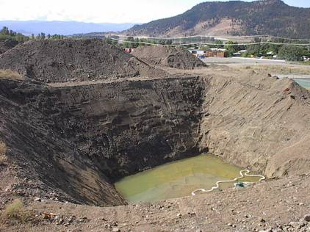
Mass Recovery Technologies
(Simple) Fluid Recovery
  Skimming
  Total Liquid Extraction; formerly dual-pump liquid extraction
  Vacuum enhanced skimming; or vacuum enhanced fluid recovery
  Multi-phase extraction (MPE)
Excavation
Refer to Tables 6.1, 6.2, 6.3
& Appendix A
LNAPL Mass Recovery
PC
MR
MC
Notes:
So here is our ternary diagram on the lower left. The dot indicates we are talking about Mass Recovery Technologies. Here are four examples of “simple” Fluid Recovery technologies. Skimming, Total Liquid Extraction, Vacuum enhanced skimming, or multi-phase extraction. As we have shown, technologies like Total Liquid Extraction, Vacuum enhanced skimming and MPE can also overlap into other groups such as Mass Control or Phase Change. You can refer to Tables 6.1 through 6.3 and Appendix A to learn more about these technologies.
We all know what excavation is. Excavation can also remove residuals. It is limited by what you can reach.

Slide 56
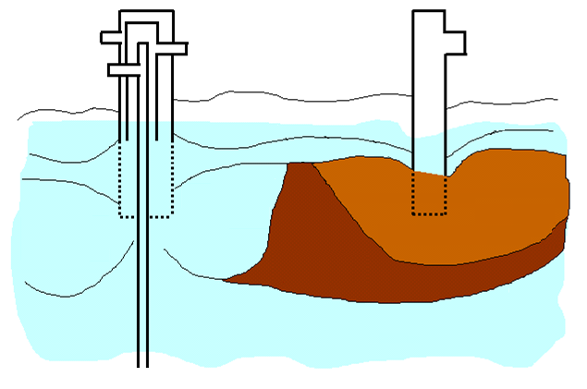
(Hot) Water Flooding – A physical technology
Refer to Tables 6.1, 6.2, 6.3 & Appendix A
Increases groundwater gradient across LNAPL
Decreases LNAPL viscosity (hot)
Source www.frtr.gov
Injection Well
Production Well
Hot Water
Hot Water Reinjection
LNAPL & Water Production
Steam
Hot
Water
Displacement
Original LNAPL
Accumulation
Residual LNAPL Saturation
LNAPL Mass Recovery
LNAPL
Bank
Hot Water Formation
PC
Steam Injection
MR
MC
Notes:
I will give you some high level examples of the mass recovery technologies
Water flooding without using hot water only increases the gradient
But Hot water flooding: also reduces the viscosity
Image source: http://www.frtr.gov/matrix2/section4/D01-4-38.gif

Slide 57
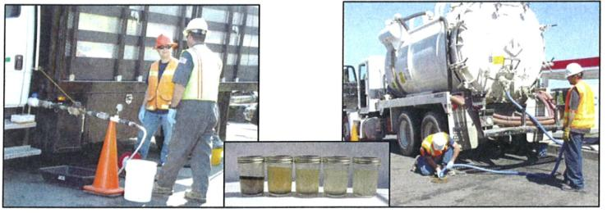
Surfactant Enhanced Subsurface Remediation (SESR) & Cosolvent Flushing
Refer to Tables 6.1, 6.2, 6.3 & Appendix A
Advantages
  Short time frame
  SESR Safety
  Cosolvent can reduce some LNAPLs to very low saturations
Disadvantages
  Single fluid waste stream complex to treat
  Permitting
Engineering
  Injection ROI (sweep volume)
  LNAPL fluid properties and injectant selection
Photo: Gold Crew
LNAPL Mass Recovery
Cosolvent Flushing
SESR
PC
MR
MC
Notes:
This is (Surfactant Enhanced Subsurface Remediation) SESR and Cosolvent flushing. These are chemical processes. You can see here the advantages, disadvantages and engineering requirements.
Graphic shows surfactant injection followed by EFR/MPE type recovery in same well
Gold Crew Release.

Slide 58
Examples of Performance Metrics
LNAPL transmissivity
  Reduction of transmissivity over time to assess performance
Asymptotic recovery
Dollars per gallon of LNAPL removed
LNAPL Mass Recovery
20
$200
LNAPL Recovery Rate
Gallons per day
10
$100
10 year cost per gallon
0
0 1 2 3 4 5
$0
Time (years)
Notes:
58
Example metrics are all about when a system has met its technological endpoint.
Here are some examples of performance metrics; Others are found in Table 5.2 and 6.3 in the Guidance Document
The LNAPL transmissivity is low, making recovery ineffective
You can use a decline curve analysis to indicate whether the system has reached its effectiveness.
The unit cost of incremental mass removal can be a metric. The cost may outweighs the benefits of the amount of LNAPL recovered. Graphic: Shows a $/gallon or LNAPL removed metric. As systems approach their endpoint, less LNAPL is recovered, while O&M costs may remain at a constant level, increasing the cost of LNAPL removing as measured as $/gallon.
58

Slide 59
Remedial Objective Grouping & Overlap
Phase Change
Biosparge/Biovent
NSZD
ISCO
Enhanced Anaerobic Degradation
AS/SVE
Vacuum Enhanced Skimming
Cosolvent Flushing
Electric Heat
Thermal Heat
Phytotechnology
Activated Carbon
MPE
Mass Recovery
Skimming
Excavation
SESR
Water flood
Mass Control
Physical or Hydraulic Containment;
In Situ Soil Mixing
Total Liquid
Extraction
Notes:
We will next talk about Phase Change Technologies. As we said some technologies fit within more than one group. An example is Phytotechnology and activated carbon with can fit within both Phase Change and Mass Control. MPE is a technology that fits into all three Groups. This is why it is often a successful technology.

Slide 60
LNAPL Remedial Technology Groups
Mass Control
Mass Recovery
Phase Change – examples of Goals
  Abate unacceptable vapor concentrations by depletion of volatiles from LNAPL
  Reduce dissolved constituents at point of compliance by sufficient depletion of soluble constituents from LNAPL
LNAPL Remedial Technologies
PC
MR
MC
Notes:
Phase Change technologies do not directly remove LNAPL as do the mass recovery technologies. Instead, LNAPL phase change technologies change LNAPL to other phases. It does this by increasing the rates of volatilization, dissolution or degradation of the LNAPL constituents.
In Phase Change technologies, an example of a Goal can be
abate vapor concentrations in the soil or vapor intruding into a building by depleting volatile constituents in the LNAPL.
Or you reduce groundwater dissolved concentrations at a point of compliance by removing soluble constituents from the LNAPL. An example is reducing benzene in the LNAPL to reduce the benzene concentrations moving into the groundwater.

Slide 61
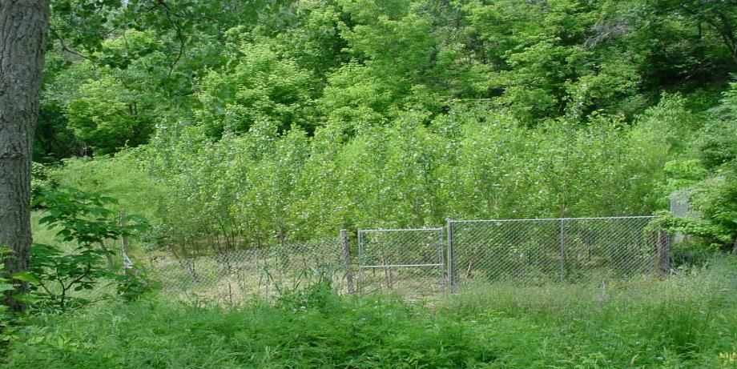
Phase Change Technologies
Ambient
  Natural Source Zone Depletion (NSZD)
  AS/SVE
  Biosparging and bioventing
  MPE; Phytotechnology
Refer to Tables 6.1, 6.2, 6.3 & Appendix A
Trees for phytotechnology
LNAPL Phase Change
PC
MR
MC
Notes:
We will now talk about ambient phase change technologies. LNAPL phase change technologies are primarily applicable to composition-based LNAPL remediation goals. The composition of the LNAPL is changed by loss of constituents that readily degrade, volatilize or dissolve from the LNAPL. Notice the dot in the ternary is now at the top, indicating Phase Change or PC.
The ambient technologies are NSZD, Air sparge and SVE, Biosparging. MPE and Phytotechnologies can also be a phase change technology
photo source: BP

Slide 62
Other Ambient Phase Change: Air Sparging/Soil Vapor Extraction;
Volatilizes LNAPL
Promotes Aerobic
Biodegradation
Refer to Tables 6.1, 6.2, 6.3 & Appendix A
Image source: ITRC LNAPL classroom training: 2015
Unsaturated
Zone
Capillary Zone
LNAPL
LNAPL Phase Change
PC
MR
MC
Notes:
62
Here is the example of air sparging and soil vapor extraction
Above the water table LNAPL, is removed through soil vapor extraction while below the water table air sparging removes LNAPL. Since soil vapor extraction relies on soil gas flow to remove hydrocarbon constituents that are volatilized, the permeability and the moisture content of the soil are important, since this will affect rate at which pore flushings and hydrocarbon removal will occur. The volatility of LNAPL is another important factor. Volatile products such as gasoline will be removed much faster than for example diesel, for which a significant fraction is non-volatile and will not be removed by soil vapor extraction.
62

Slide 63
Performance Metrics for Phase Change Technologies
See Tables 5.2 and 6.3 for additional metrics
Dissolved phase concentration is stable or decreasing
Soil concentrations stable or decreasing; endpoint reached when reduced to regulatory limits.
Asymptotic performance of the recovery system
Volatile or soluble constituents reduced to risk-based standards
LNAPL Phase Change
PC
MR
MC
Notes:
Here are some example SMART performance metrics for Phase Change Technologies:
The dissolved phase concentration is stable or decreasing
The soil concentrations are stable or decreasing
you see an asymptotic performance of the recovery system
volatile or soluble constituents of concern are reduced to risk-based regulatory standards in media of concern
Other possible metrics are suggested in Tables 5.2 and 6.3

Slide 64

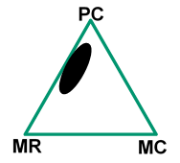
In Situ Thermal Technologies
Mass Control
Mass Recovery
Phase Change
Notes:
Finally, we will next talk about In Situ Thermal technologies.
These are both mass recovery and phase change technologies.

Slide 65
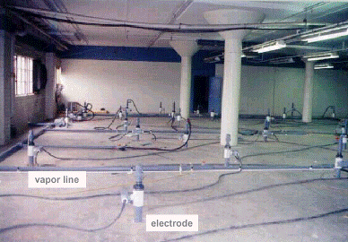
Heating Technologies
Steam / Hot Air Injection
Others
  In Situ Smoldering (primarily combustion)
  Thermal Conduction Heating
  Electrical Resistance Heating
  Image source: http://hillafb.hgl.com
Vapor line
LNAPL Phase Change
Electrode
PC
MR
MC
Notes:
The photo is an example of Steam or Hot Air injection. Another technology is In Situ smoldering, which is primarily a combustion process.
Others are thermal conduction heating and electrical resistance heating.
Image source: http://hillafb.hgl.com/steam_cartoon.gif

Slide 66
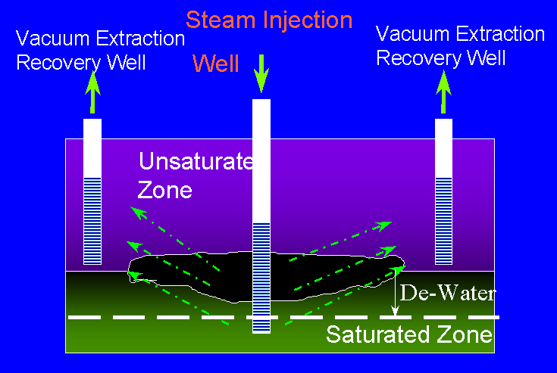
In Situ Thermal Technologies
Increases LNAPL volatility
Reduces LNAPL viscosity
SVE for recovery of
volatilized LNAPL
Hydraulic recovery of
mobilized LNAPL
Better in low groundwater
velocity settings (<heat loss)
PC
MR
MC
LNAPL Phase Change/Mass Recovery
Image source: http://hillafb.hgl.com/steam
Notes:
These In Situ heating technologies increase the LNAPL volatility and reduces the viscosity. For these technologies, both SVE for volatilized LNAPL and hydraulic recovery is likely needed. And they are better in low groundwater velocity settings.
So now you have a snapshot of the 21 technologies, their groupings and how to select them. You can find more about all of these technologies in the Guidance Document.
Next I will turn it over to Justin Meredith and Joann Dyson.

Slide 67
In Situ Thermal Technologies Metrics
LNAPL transmissivity
Soil concentration at regulatory standard
Dissolved phase concentration at regulatory standard
Cost per unit volume removed
Asymptotic mass removal
Also refer to Tables 5.2 and 6.3
LNAPL Phase Change/Mass Recovery
PC
MR
MC
Notes:
Here are some example metrics for In Situ Thermal Technologies. They are similar to other technologies. LNAPL transmissivity is a good one. You can have soil concentrations or dissolved phase concentrations at regulatory standards. And also like we have discussed: Cost per unit volume removed and asymptotic curve for mass removal. Just make sure and refer to Tables 5.2 and 6.3 in the guidance document.
So now you have a snapshot of the 21 technologies, their groupings and how to select them. You can find more about all of these technologies in the Guidance Document.
Next we will have a Q&A. Then we will turn it over to Justin Meredith of the Tennessee Department of Environment and Conservation and Joann Dyson of West Central Environmental Consultants.

Slide 68

Q&A Break
Follow ITRC
1st Question and Answer Break
Notes:
No associated notes.

Slide 69
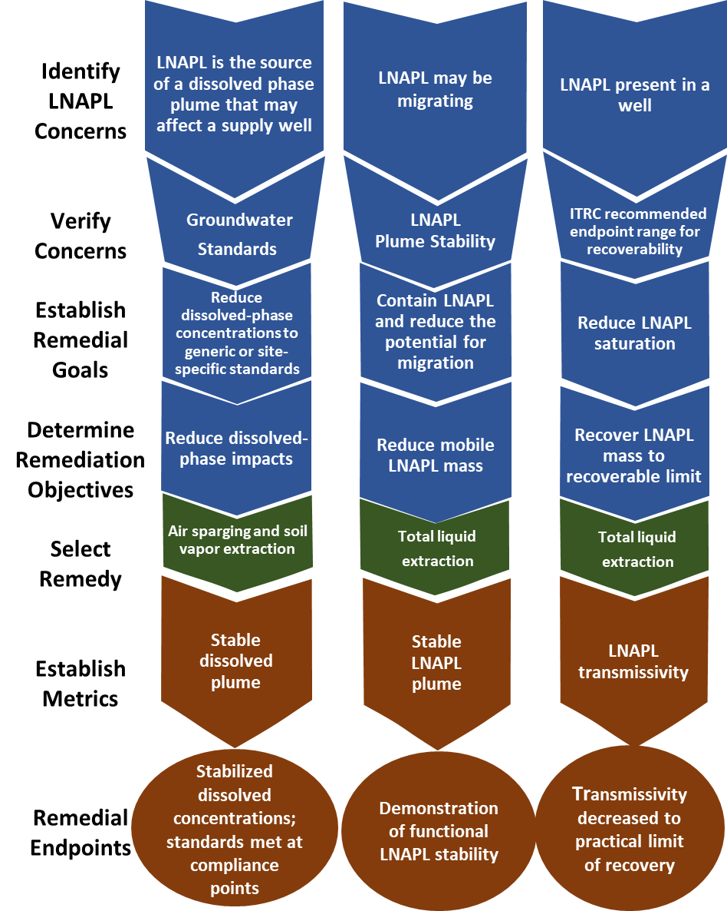
ITRC LNAPL Management Strategy
What do you have?
What needs to be done?
Introduction
How to address it?
ITRC LNAP-3, Figure 5.2
Notes:
69
[Regulator]
Let’s take another look at this flow chart to remind us where we are in the LNAPL management strategy presented in the Guidance document.
[CLICK] The previous two training sessions covered how to determine “what you have” and “what needs to be done”. [CLICK] Now we can start making informed decisions about remedial technology selection to address it.
69

Slide 70
LNAPL Remediation Technology Selection
Learning Objectives:
Learn about the Technology Selection Process
Apply Remedy Selection Process to a real site
How do I choose a remedy?
Objectives
Notes:
[Regulator]
The objectives for this portion of the training are to learn the technology selection process and, ultimately, to be able to apply the Guidance from start to finish to a real site, which incorporates all three trainings.
[CLICK] We’re going to start with an overview of the technology selection process.

Slide 71
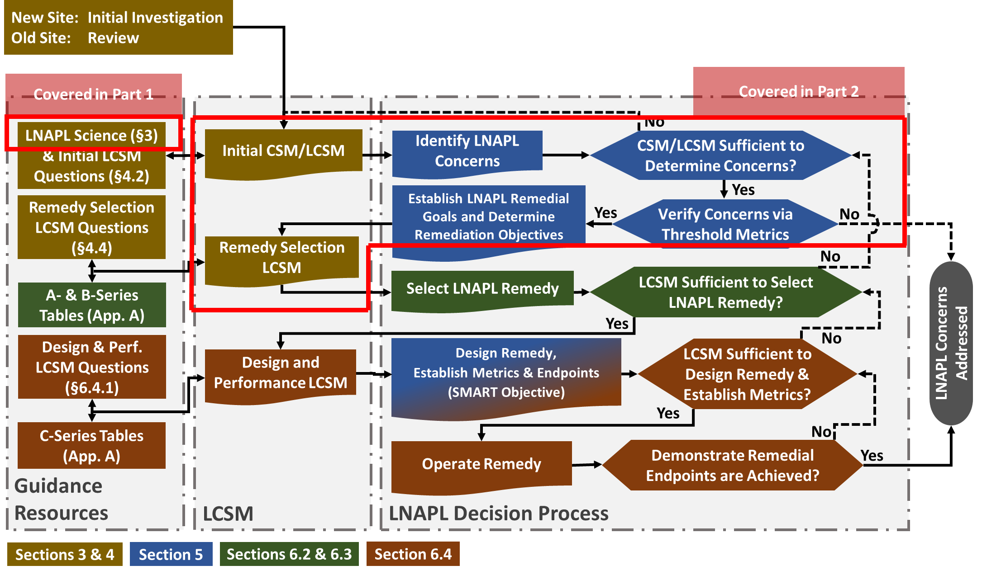
Guidance Process Flow Diagram
Sections 4 and 5
Handout provided
Covered in Trainings 1 & 2
Trainings 1 & 2 Review
ITRC LNAPL-3, Figure 1-1
Notes:
71
[Regulator]
Trainings 1 & 2 covered topics in this portion of the Guidance Process Flow Diagram.
71

Slide 72
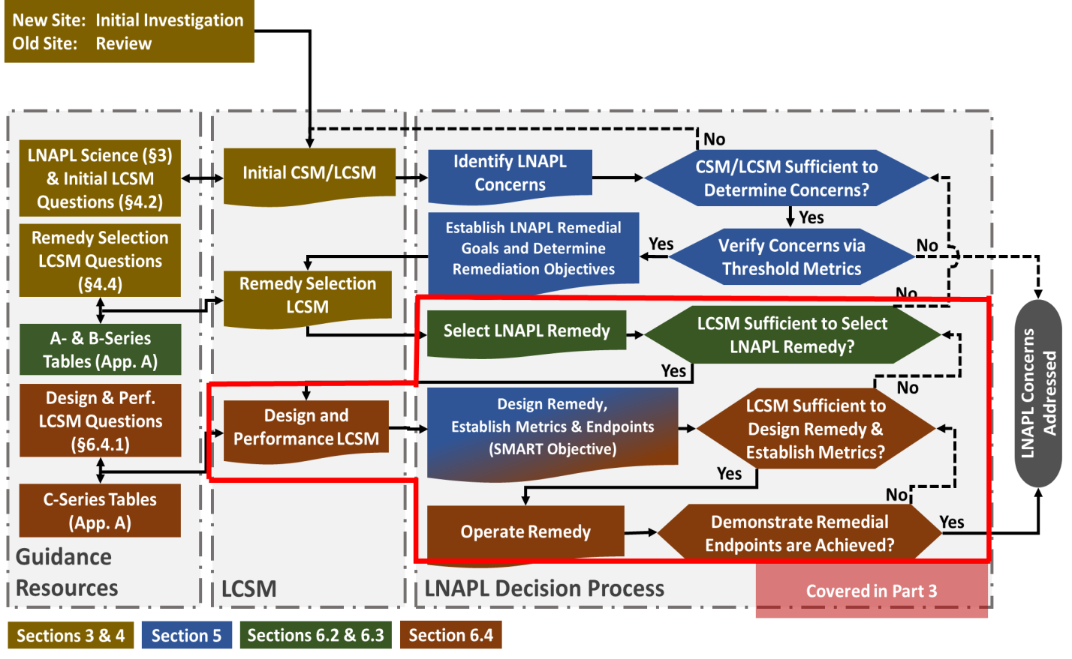
Guidance Process Flow Diagram
Section 6
Training 3
Training 3 Preview
ITRC LNAPL-3, Figure 1-1
Notes:
72
[Regulator]
In Training 3, we will cover topics in this portion of the Guidance Process Flow Diagram, but you will see that we will be using the knowledge gained from Trainings 1 & 2.
72

Slide 73
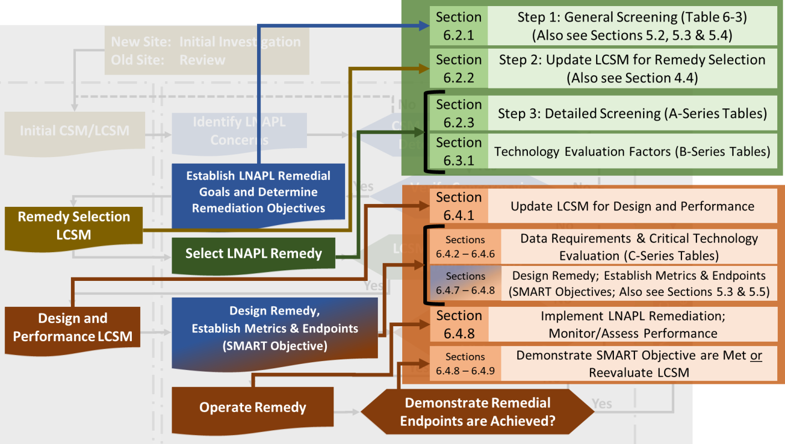
Guidance Process Flow Diagram: Figure 6-1
Effectiveness
Implementability
Implementation
Technology Selection Process Overview
ITRC LNAPL-3, Figure 6-1
Notes:
73
[Regulator]
Here’s a portion of the process flow diagram with details added to show you that each box in the diagram can represent more than one action. This is Figure 6-1 in the LNAPL Guidance.
The remedial technology selection process involves a [CLICK] preliminary screening, which screens the technologies for effectiveness. The goal of Step 1 is to identify all possible LNAPL technologies for your site from the list of 21 technologies presented in this Guidance. Step 1 uses your site-specific LNAPL concerns, remedial goals and remediation objectives along with Table 6-3 to determine a subset of technologies that fit your site. So all of the information from the three training classes comes together when it’s time to determine a remedial technology. In step 2, you reevaluate your LCSM based on your list of technologies from Step 1 and determine whether it needs updating. This may include collecting additional data or further evaluating goals & objectives. In Step 3, you further screen the technologies in your list based on site-specific geologic factors and information found in the A-series tables in Appendix A. This completes the preliminary screening, leaving a short list of possible technologies to further consider for your site.
This initial screening is followed by [CLICK] an evaluation of the technologies in your short list for implementability using factors found in the B-series tables in Appendix A. [CLICK] The remaining steps evaluate the technologies for implementation using the C-series tables in Appendix A. Keep in mind that at several points throughout the technology selection process, you should reevaluate your LCSM and update it, if necessary.
73

Slide 74
Technology Tables - Appendix A
Guidance Document Appendix A
  3 different types of tables for each of the 21 technologies
  Called the A-, B-, and C-series tables
    A-series – general information and applicable geologic conditions
    B-series – evaluation factors to consider
    C-series – technical implementation consideration
  Key literature references presented in the tables
Basics – Appendix A
Key Point: Appendix A presents typical technology applicability to site conditions as concluded by the LNAPL Team. This doesn’t mean you can’t apply the technology in a setting different.
Notes:
[Regulator]
I’m going to take a minute here to discuss Appendix A. Appendix A contains three different types of tables for each technology. These three tables are called the A-, B-, and C-series tables. The A-series table contains general information about a technology and geologic conditions under which the technology is applicable. The B-series table lists more detailed factors to use in evaluating a technology for your site. And the C-series table will contain technical information to consider before implementation.
These tables are a good place to start if you want to learn about a specific technology, but we will show you how to use the information during the remedy selection process to help narrow the list of possible technologies.

Slide 75
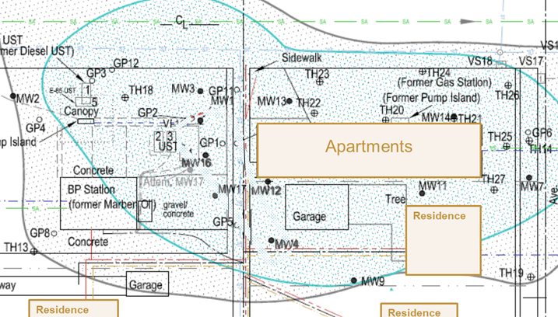
Case Study - LNAPL Remedial Technology Selection
Learning Objectives:
Learn the Technology Selection Process
Apply Remedy Selection Process to a real site
I wonder how LNAPL was remediated at this site.
Regulator
Case Study
Notes:
[Regulator]
That was a quick overview of the technology selection process. Now we’ll go through a case study so we can show you how to apply the document to a real site and the details of each of those steps. Here to help me is…..[Consultant].
I’m a regulator and I’m interested in knowing more about this LNAPL site that you remediated and how you used this LNAPL process as a consultant. Can you tell me about it?

Slide 76
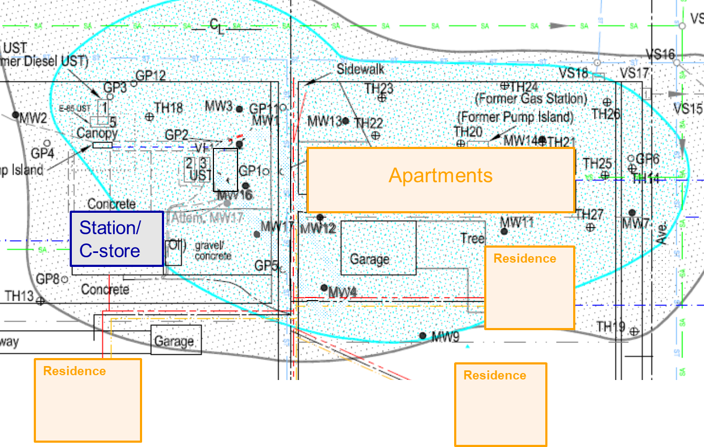
Case Study: LCSM
Gasoline
UST piping leak
Dissolved phase COC > regulatory limits: BTEX, MTBE and 1,2-DCA
Case Study
  Water table ~5-6 ft bsg (+/- 2.5 ft)
  Groundwater flow: E & SE; also NE
  Residential area
Notes:
[Consultant]
I’d be happy to discuss this project with you. First I’ll tell you about the site. This was an active filling station with a small convenience store. In 2000 [CLICK], a leak was discovered that was determined to be a piping leak from a gasoline underground storage tank. Through groundwater monitoring over several years, we knew the water table [CLICK] was typically 5-6 feet below surface grade, but fluctuated seasonally as much as 2.5 feet above and below this level. Groundwater flow was observed to the E and SE the majority of the time [CLICK], but was also observed to the NE. The dissolved-phase contaminants of concern [CLICK] above regulatory limits were BTEX compounds, MTBE, and 1,2 dichloroethane (or 1,2-DCA). There were apartments and residences surrounding the station, and the residences all have basements and sump pumps, and there’s an alley that runs between the site and apartments with a utility corridor.
All of this information was used to build our initial LCSM for the site. Section 4 of the LNAPL Guidance discusses the evolution of the LCSM through corrective action. Section 4.2 provides key questions to guide the development of the initial LCSM, such as…”is the source and extent of the LNAPL known”, “are dissolved or vapor plumes characterized”, and “are exposure pathways complete”?
At this point in our investigation, the source appeared to be limited to the tank basin area, and we had characterized the dissolved phase plume. The source area was likely larger at one time based on the size of the dissolved-phase plume. Since vapors were a concern, we referred to the ITRC Petroleum Vapor Intrusion (or PVI) document. Section 3.3 shows we would need a vertical separation of at least 5 feet between the building foundation and the water table due to the dissolved phase plume to say we have an incomplete pathway with no further investigation needed. At this site, our water table was typically 5-6 feet bsg, but fluctuated, so the vertical separation was too small to discount vapor intrusion, especially since the basements are approximately 6 feet bsg. Since we needed to learn more about the exposure pathways, we started monitoring the vapors below the apartment building and soil gas near the downgradient residences.

Slide 77
Case Study: LCSM
UST leak
MW1 – LNAPL (<0.5 ft)
Apartments
MW16
Station/
C-store
M
MW12
Case Study - LCSM
Residence
MW4
MW4 – LNAPL (up to 0.8 ft)
Residence
Residence
Notes:
[Consultant]
After about 3 years of groundwater monitoring, LNAPL appeared in monitoring well MW1 with thicknesses always less than 1/2 foot. With this new observation, we clearly needed to define the extent of LNAPL outside the tank basin and re-develop our LCSM. An LIF investigation was performed to delineate the source and determine the extent of LNAPL. This investigation indicated a gasoline LNAPL body around MW1 [CLICK] and to the SE toward the alley, with LNAPL at a depth of approximately 8 feet bsg.
About 8 yrs. after the release, [CLICK] LNAPL was observed in the downgradient offsite well MW4 at thicknesses up to 0.8 feet. We noticed this occurred when the water table at the site dropped 3-5 feet. An additional LIF investigation was conducted, to see if we could determine if LNAPL had migrated in the past from MW1 to MW4 and was now exposed by the dropping water table, or if LNAPL was migrating during current low water table conditions.

Slide 78
Case Study: LCSM
MW1
Migrating LNAPL
Apartments
Station/
C-store
Case Study - LCSM
Residence
MW4
Residence
Residence
  Potential vapor intrusion at adjacent apartments
  Potential risks to residences (basements/sump pumps)
Notes:
[Consultant]
This additional LIF investigation showed LNAPL along the path from MW1 to MW4 that was previously not observed, indicating LNAPL had migrated under the current low water table from the area around MW1 to the residential property to the SE. [CLICK] We already knew there were potential vapor intrusion risks at the adjacent apartments and nearby residences due to dissolved-phase contamination, but now there was a potential risk of LNAPL in basements or sumps of downgradient residences if migration continued. Referring back to the question in Section 4.2 of the Guidance about the LNAPL source and extent – we now knew the LNAPL body was not stable, but migrating to the SE, so the extent was unknown.

Slide 79
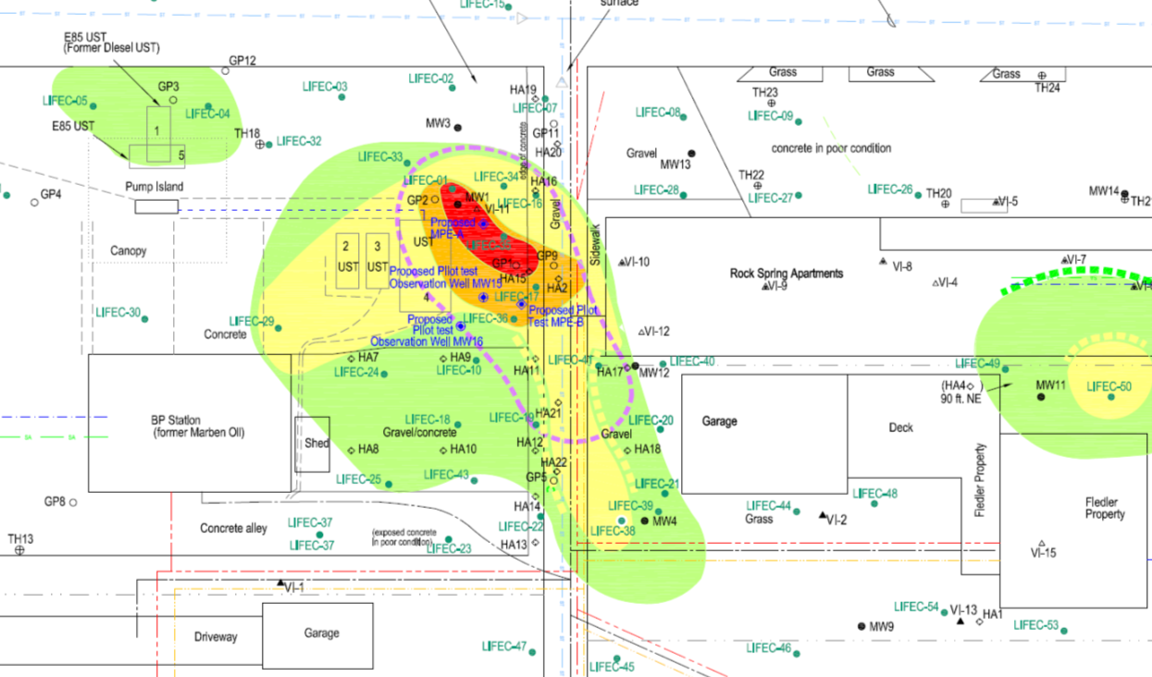
Case Study: Cross-section Plan View
B
LNAPL
A’
Apartments
A
Case Study - LCSM
Station/ C-store
Residence
B’
← Residence
Residence →
Notes:
[Consultant]
This plan view shows the LNAPL plume determined from the LIF investigations, with the red indicating the most saturated area. Next, we’ll look at two cross-sections where we can see the site heterogeneity and the vertical distribution of the LNAPL {CLICK} Cross-section A-A’ runs west to east across the site and includes the tank basin area and the apartments. [CLICK] Cross-section B-B’ runs northwest to southeast and includes the LNAPL migration path from MW1 to MW4.

Slide 80
Case Study: Cross Section A-A’
A’
Apartments
(in foreground)
Case Study - LCSM
High Water Table
Low Water Table
LNAPL
Notes:
[Consultant]
Cross Section A-A’ shows that the
- Native soil is mainly clay-rich till. There are sand lenses from 4 inches to 5 ft thick located throughout at depths of 5-26’ bsg.
- High water table is shown by the blue line. Low water table is shown by the red line.
- LNAPL body below MW1 is labeled.

Slide 81
Case Study: Cross Section B-B’
Case Study - LCSM
High Water Table
LNAPL
Low Water Table
Notes:
[Consultant]
Cross Section B-B’ includes MW1 and MW4:
Again, the high water table and low water table.
And the LNAPL body can be seen below MW1 and MW4; the smear zone around MW4 is only in the lower half of the fluctuating water zone.
(No apparent permeable sand lenses observed in the upper depths.).

Slide 82
Case Study: Step 1 - General Screening
Basics – Screening Step 1
Goal: Identify a subset of possible LNAPL technologies
  LNAPL concerns, remedial goals, remediation objectives (LNAPL Trainings 1 & 2)
  Table 6-3
ITRC LNAPL-3, Section 6.2.1
Notes:
[Regulator]
It looks like you developed a thorough LCSM for this site. I know the first step in remediation selection is to determine remedial goals and remediation objectives based on site concerns, and use those along with Table 6-3 to develop a sub-set of possible technologies. So this step uses concepts that were developed in Trainings 1 & 2. From a Regulator perspective it looks like there are a lot of concerns for this site involving the protection of human health and the environment. Can you take me through this first screening step for your site?

Slide 83
Case Study: Site LNAPL Concerns
LNAPL migrated SE during low groundwater elevations
Large dissolved plume above regulatory limits
  COC: BTEX, MTBE and 1,2-DCA
Vapor plume
  Potential vapor intrusion at adjacent apartments
  Potential risks for residences (basements/sump pumps)
**Site moved to aggressive site status by Agency
Case Study – Step 1
Notes:
[Consultant]
There were several concerns at this site – mobile LNAPL migrating to the SE during periods of low groundwater; dissolved-phase contamination above regulatory limits; and potential vapor intrusion issues. Although not a concern, an additional factor we did have to consider was that the site was added to “aggressive site cleanup” status by the regulatory agency.

Slide 84
Knowledge Check
Which concern would you consider to be the highest priority for this site?
  Migrating LNAPL
  Large dissolved plume above regulatory limits (COCs: BTEX, MTBE, 1,2-DCA)
  Vapor plume/vapor intrusion risks to off-site properties
Poll Question
Notes:
[Regulator]
Let’s do a poll (knowledge check) question.
Results…
Joann what did you decide for this site?

Slide 85
Case Study: Site LNAPL Concerns
LNAPL migrated SE during low groundwater elevations
Large dissolved plume above regulatory limits
  COC: BTEX, MTBE and 1,2-DCA
Vapor plume
  Potential vapor intrusion at adjacent apartments
  Potential risks for residences (basements/sump pumps)
**Site moved to aggressive site status by Agency
Case Study – Step 1
Notes:
[Consultant]
We decided to concentrate on the migrating LNAPL, knowing that in addition to the risk of the LNAPL itself entering a basement or sump, this could create higher dissolved-phase and vapor intrusion risks at the downgradient residences if migration continued. We also realized that it may be possible to address more than one concern with the right technology.

Slide 86
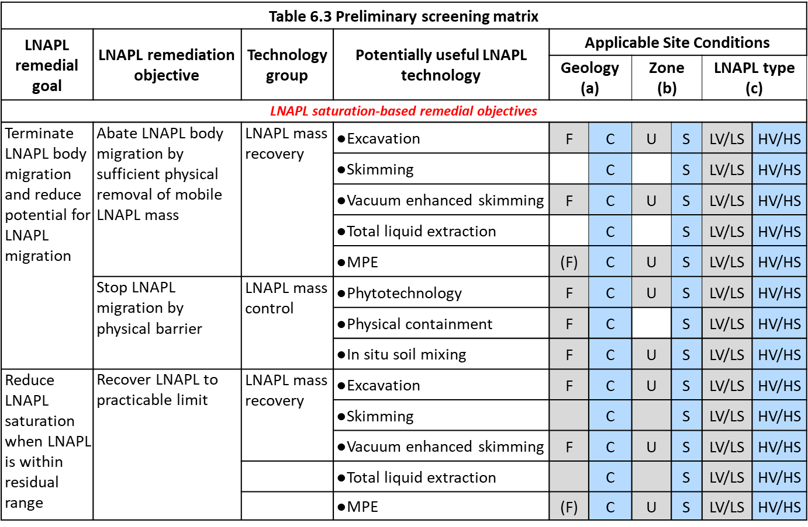
Case Study: Step 1 – Goals, Objectives & Table 6-3
Case Study - Step 1
Notes:
[Consultant]
For Step 1 of the screening process, we needed to identify a goal and objective to remediate our migrating LNAPL concern. Here’s a Section of Table 6-3. The columns are…remedial goals, remediation objectives, technology groups, possible technologies, and applicable site conditions. The full table includes an additional column after site conditions with examples of performance metrics that we will discuss later.
For Step 1, we determined that the LNAPL remedial goal from Table 6-3 [CLICK] that corresponded to our concern was “Terminate LNAPL…”.
The remediation objective we selected [CLICK] to accomplish our goal was “Abate LNAPL…”.
To achieve this objective, we would use technologies [CLICK] in the LNAPL mass recovery technology group, which includes [CLICK] these 5 LNAPL technologies: “Excavation, Skimming….” So these are the technologies we initially considered.

Slide 87
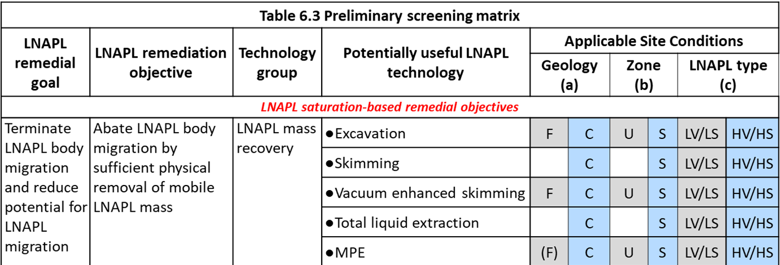
Case Study: Table 6-3 Geologic Factors
Basics – Table 6-3
  Geology
    Fine grained soils (F)
    Coarse grained soils (C)
  Zone
    Unsaturated zone (U)
    Saturated zone (S)
  LNAPL type
    Low Volatility/Low Solubility (LV/LS)
    High Volatility/High Solubility (HV/HS)
ITRC LNAPL-3, Section 6.2.1
Notes:
87
[Consultant]
Even though the full list of geologic factors and detailed information can be found in the A-series Tables in Appendix A, Table 6-3 summarizes three factors [CLICK] for each of the technologies listed, providing an additional screening of the technologies. The geologic factors on Table 6-3 include:
- geology – whether the soils at the site are fine or coarse grained;
- the impacted zone – is LNAPL in the saturated or unsaturated zone;
and the LNAPL type – whether you have low volatility and solubility or high volatility and solubility.
Since our site was mainly fine grained, [CLICK] we were able to eliminate skimming and total liquid extraction since these technologies are most successful when applied to sites with coarse grained soils.
87

Slide 88
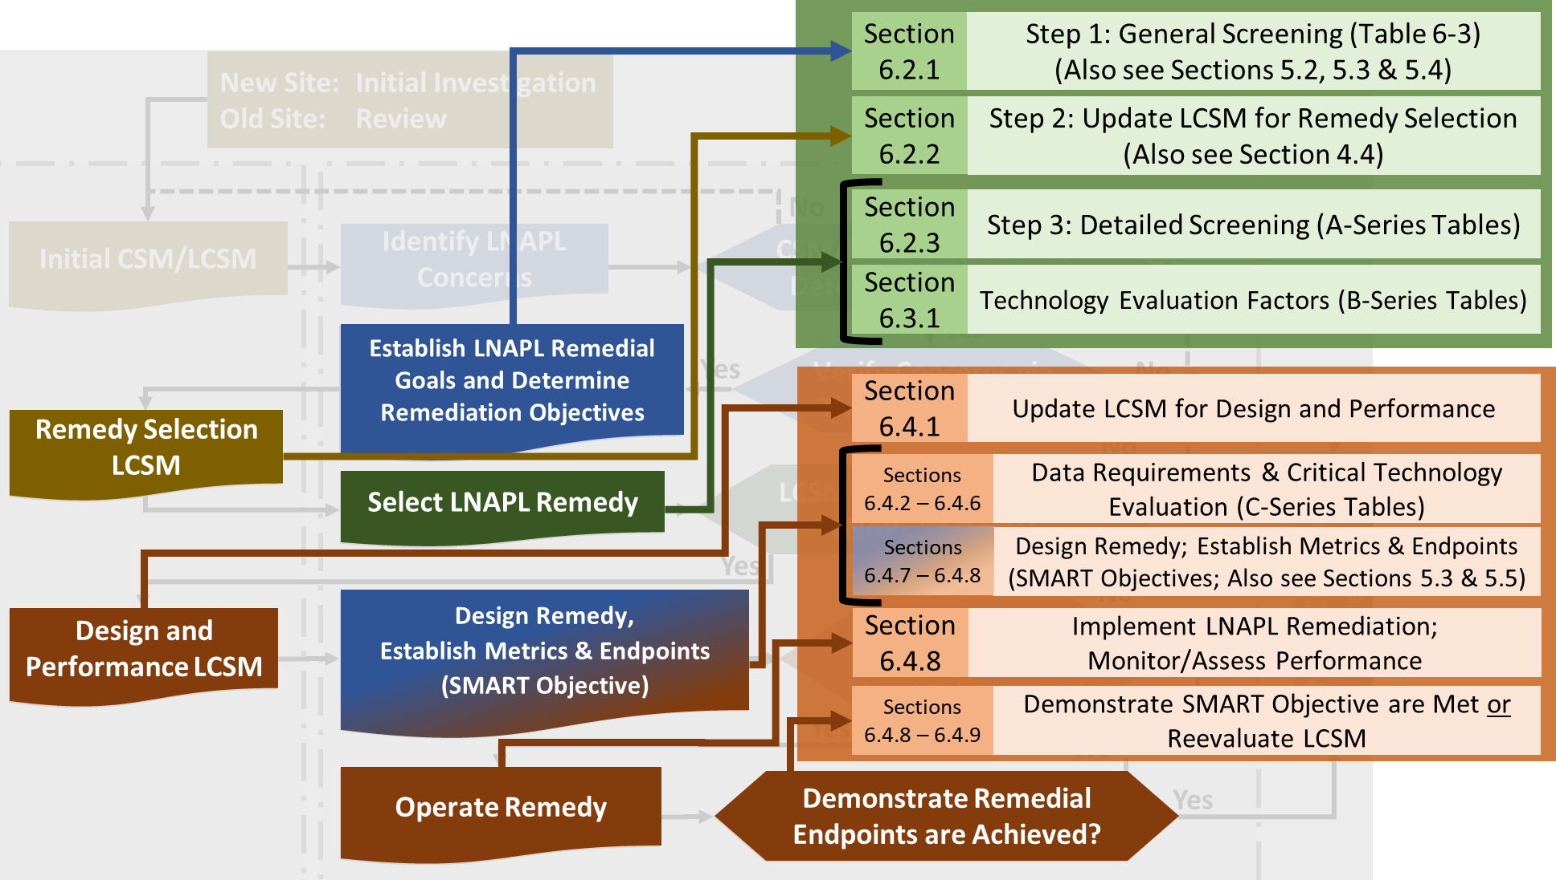
Case Study: Step 2 – Update LCSM
Case Study – Step 2
Basics – Screening Step 2
Step 2: Reevaluate/update the LCSM
  May need to collect additional data
  Further evaluate goals & objectives
ITRC LNAPL-3, Section 6.2.2
Notes:
88
[Regulator]
It sounds like you made a good decision to eliminate skimming and total liquid extraction. I’m assuming you reevaluated your LCSM at this stage. We certainly don’t want to get too far ahead of ourselves and doing this adds an extra layer of comfort to ensure the protection of human health and the environment. So this is the next step in the technology screening process. Was your LCSM thorough enough to move forward with the three remaining remediation technologies in your list?
88

Slide 89
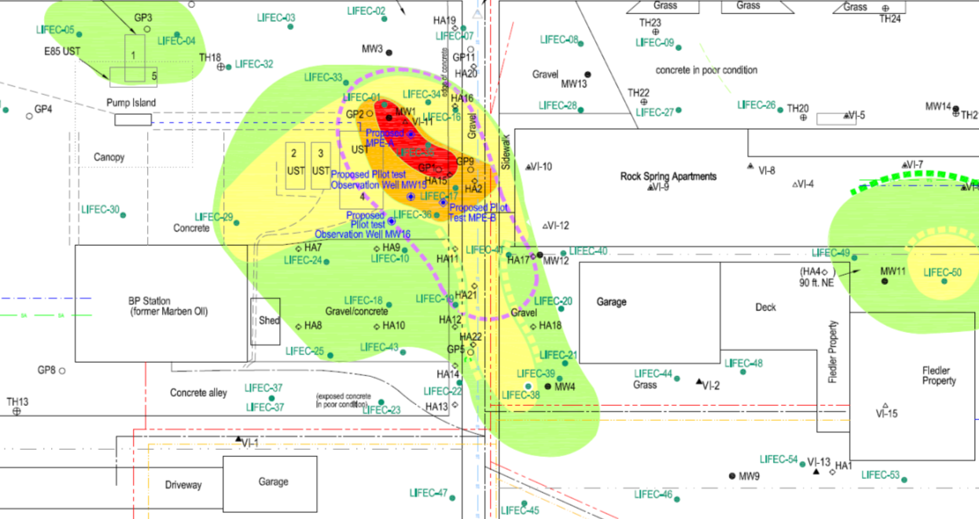
Case Study: Step 2 – Update LCSM
Apartments
Station / C-Store
Case Study – Step 2
Residence
    No additional field work:
    LIF data already collected at the site
    LNAPL source below the water table
    Low permeability soils at the site
← Residence
Residence →
Notes:
[Consultant]
Section 4.4 of the LNAPL Guidance has key questions for developing the Remedy Selection LCSM, which range from general topics to more LNAPL specific topics. Some questions focus on the source, such as “where is it” and “how is it distributed above and below the water table”, and includes others such as, “what’s achievable for a given technology”.
After reviewing these topics, we determined that we did not have to collect any additional field data to move forward; we had already completed two LIF investigations in addition to other investigations, and we had the data we needed. Some of the elements of the LCSM that were important for remedy selection included…knowing the permeability was low and that the source was submerged below the water table.

Slide 90
Case Study: Step 3 – Detailed Screening
Basics – Screening Step 3
Step 3: Refine technology list using:
  Site-specific geologic factors
  A-series technology tables (Appendix A)
ITRC LNAPL-3, Section 6.2.3
Notes:
90
[Regulator]
Ok. Now Step 3 of the selection process would be to screen the remaining possible technologies from Step 1 using geologic factors and the A-series tables in Appendix A. Were you able to narrow down your list of three technologies based on additional site geologic factors?
90

Slide 91
Case Study: Step 3 - Geologic Screening
Basics – A-series Table
Notes:
[Consultant]
Those tables were helpful. In addition to geologic factors, the A-series tables have some general information about the technologies. For example, here’s the A-series table for vacuum-enhanced skimming. The top is condensed here for easier reading, but you can see there is a [CLICK] description of the technology, the remediation process, objective applicability and applicable LNAPL type. [CLICK] Geologic factors are at the bottom and include information for both [CLICK] the unsaturated and saturated zones, including [CLICK] permeability, grain size, heterogeneity and consolidation for both zones. In particular, the information about saturated zone permeability was beneficial to our screening process.

Slide 92
Case Study: Step 3 – Geologic Screening (A-2-A Skimming)
Excerpt from Table A.3.A. Vacuum-Enhanced Skimming
Geologic factors | Saturated zone | Permeability | Can achieve faster LNAPL removal and lower LNAPL saturations in higher-permeability materials.
Site Geologic factors
  Saturated zone impacts
  LNAPL in higher permeable lenses
  Mainly lower permeable soils
  Heterogeneous soil profile
  Technology Short List
  excavation
  skimming
  vacuum enhanced skimming
  total liquid extraction
  multi-phase extraction
Case Study – Step 3
Notes:
[Consultant]
The permeability description told us that vacuum enhanced skimming would be more successful in higher permeability soils. Although LNAPL at the site is in higher permeable lenses, most of the site has lower permeability soil. [CLICK] Based on this, we determined that vacuum enhanced skimming was not a good fit for this site. We repeated this geologic screening for the other two technologies on the short list and decided they were both applicable to this site. So after the preliminary screening process, we had 2 technologies remaining in our short list.

Slide 93
Case Study: Technology Evaluation Factors
If one technology: reevaluate goals.
Basics – Evaluation Factors
Further Evaluation: Refine technology short list using:
  Technology evaluation factors (Table 6-4)
  B-series tables
ITRC LNAPL-3, Section 6.3.1
Notes:
93
[Regulator]
If only one technology had been left after the preliminary screening process, you would have needed to reevaluate site goals or objectives. If you still had only one technology, this next evaluation [CLICK] might be used to identify any “show stopper” concerns before moving forward with that technology. This step involves further evaluation of the technologies remaining in your short list using evaluation factors on Table 6-4 and the B-series tables.
93

Slide 94
Case Study: Table 6-4 Evaluation Factors
Remedial time frame
Safety
Waste stream generation and management
Community concerns
Environmental factors
Site restrictions
LNAPL body size
Cost
Other
Review factors
Rank top 4-6 factors
Review “B-series” tables
Basics – Evaluation Factors
Notes:
94
[Regulator]
Here are the nine evaluation factors included in Table 6-4. The next step in the process involves reviewing these evaluation factors and ranking the top 4-6 of these based on your site considerations, then using the B-series tables to compare the technologies.
94

Slide 95
Case Study: Table 6-4 Evaluation Factors
Example from Table 6-4. Evaluation Factors
Site Restrictions | Defined | Physical, logistical or legal obstacles to system deployment at the site (e.g., building locations, high-traffic areas, small property size, noise ordinances…or nearby sensitive receptors, such as schools, day cares, hospitals, etc.)
 | Impact | Site restrictions and limitations impact the implementation of some technologies more than others, due to equipment size, degree of surface disruption, etc. At sites with more potential physical, logistical, or legal site restrictions, the physically larger, more “disruptive” technologies may be less feasible to implement.
Basics – Evaluation Factors
Notes:
95
[Regulator]
Here’s an example from Table 6-4 for Site Restrictions. Table 6.4 defines each evaluation factor and gives general examples of possible impacts to selecting a technology. What evaluation factors were important for this site?
95

Slide 96
Case Study: Evaluation Factors
Remedial Time Frame
Site restrictions
Waste Stream Management
Safety
  Priority cleanup site by regulatory agency
  No sewer connections
  No 3-phase power nearby
  Many underground utilities
Case Study – Evaluation Factors
  Cannot handle large waste water volume
  Small site
  Active gas station
  Adjacent to highway & residential area/apartments
Notes:
[Consultant]
We decided these four factors were the most important for this site…remedial time frame, safety, waste stream generation and management, and site restrictions, with this priority.
Remedial time frame [CLICK] was the most important factor and needed to be short, because the regulatory agency had placed the site on the priority cleanup list. [CLICK] Site restrictions included no sewer connections, no 3-phase power nearby, and many underground utilities. [CLICK]
Waste stream management was a factor because this would be necessary for any of the technologies being considered. Vapors and noise mitigation were doable, but the site could not easily handle a large volume of waste water. [CLICK] Safety was a concern because the site is small, it’s an active station, and it’s located near a highway and residential area, so there’s also foot traffic.

Slide 97
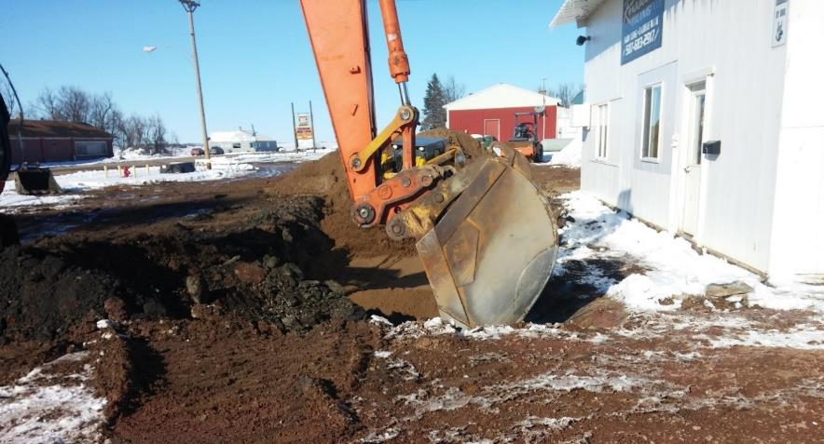
Case Study: B-Series Table –Excavation
Technology: | Excavation
Site Restrictions | Concern | High
 | Discussion | Disruptive technology. Physical space, and logistical demands significant. Often excavation is infeasible due to site improvements, buildings, structures, roads, etc. Due to the use of large, heavy equipment and the need…
Basics – B-series Tables
Photo: WCEC
Notes:
[Regulator]
The B-series Table in Appendix A gives specific impacts of each of the nine evaluation factors for each remedial technology. In this example for excavation, we see that site restrictions is a high concern [CLICK], and there’s a discussion giving details to consider.

Slide 98
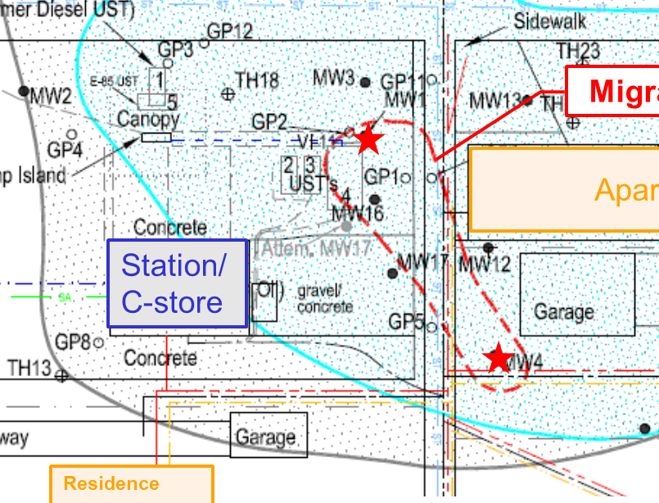
Case Study: Evaluation Factor Screening
Evaluation Factorss | Excavation (A-1.B) | Multi-Phase Extraction (A-5.B)
Remedial Time Frame | Low | Moderate
Site Restrictions | High | Moderate
Waste Stream Management | Moderate to High | Moderate
Safety | Moderate | Moderate
Case Study – Evaluation Factors
Small site
Active tank basin
Apartment building
Alley with utilities
Offsite garage
Notes:
[Consultant]
We created a table to compare the evaluation factors for the two technologies still being considered. The four evaluation factors are on the left side and our two remaining technologies are along the top. We then referred to the B-series tables to add the concern level for each factor.
We started [CLICK] by noting the high concerns, which were for site restrictions and waste stream management. This site was heavy in infrastructure in the area of concern such as the active tank basin, apartment building, the alley with utility corridor and an offsite garage. So even though the remedial time frame for excavation was low [CLICK], which was a priority, there were too many high concerns [CLICK], so excavation was eliminated. There were no high concerns for MPE, so [CLICK] it was retained for further consideration.

Slide 99
Case Study: LCSM Update
Update LCSM for design and performance :
  Performance metrics
  C-series Tables
Basics – LCSM Update
ITRC LNAPL-3, Section 6.4.1
Notes:
99
[Regulator]
The next step is to review the LCSM based on the design and performance metrics provided in the C-series Tables for the technologies that are still being considered. The LCSM for a site must include knowledge related to these metrics if the technology is to be employed at the site.
99

Slide 100
Case Study: Design and Performance LCSM Update
Table A-5-C Technical implementation considerations for MPE
Basics – LCSM Update
Notes:
100
[Regulator]
Let’s look at an example of the design and performance metrics from the C-series Table for MPE. Examples of design metrics include number of extraction wells and conveyance piping. Examples of performance metrics include GW and LNAPL recovery rates and volumes. Information related to these data requirements and metrics should be part of the LCSM since these will need to be part of the full-scale design and then measured to show MPE was successful. Was it necessary for you to update your LCSM for MPE to still be considered?
100

Slide 101
Case Study: Design and Performance LCSM Update
Section 6.4.1 Design and Performance LCSM
What are the conditions to be created by the selected technology(s) that will accelerate LNAPL depletion?
What conditions will demonstrate the desired LNAPL changes?
Case Study – LCSM Update
Notes:
101
[Consultant]
This was a good time to refer to the design and performance LCSM questions in Section 6.4.1 to help us review our LCSM. By answering these questions, the metrics and endpoints will be on their way to SMART.
1. What are the conditions… Lowering the water table was one condition.
2. What conditions will demonstrate… Considering our endpoints for technology implementation was important here. In this case, our endpoints included reduced LNAPL occurrence and declining groundwater concentrations.
We had a lot of site information at this point that was necessary for implementation, such as depth to the bottom of NAPL zone, that was the target for dewatering. However, we did need to update our LCSM with information such as the ROI of dewatering and vacuum extraction.
101

Slide 102
Case Study: Data Requirements
Further Evaluation:
  Minimum data requirements & critical technology evaluation
  C-series tables
Basics – Data Requirements
ITRC LNAPL-3, Section 6.4
Notes:
102
[Regulator]
The next step in the process is to review the minimum data requirements and the critical technology evaluation needed for any remaining technologies using the C-series tables in Appendix A.
102

Slide 103
Section 6 – Minimum Data Requirements and Critical Considerations For Technology Evaluation
Table A-5-C. Technical implementation considerations for MPE
Data requirements | Site-Specific data for technology evaluation | Hydraulic conductivity/transmissivity; LNAPL conductivity/transmissivity; LNAPL characteristics, power availability…
 | Bench-scale testing | N/A
 | Pilot-scale testing | GW and LNAPL ROC; GW and LNAPL recovery rate, volume & influent concentrations; vacuum and flow...
 | Full-scale design | Number of extraction wells; conveyance piping; GW and LNAPL ROC; and LNAPL emulsification issues.
 | Performance metrics | GW/LNAPL recovery rates and volumes; system uptime vs downtime; cumulative GW/LNAPL recovery…
Basics – Data Requirements
Determine minimum data requirements
Further evaluate considering critical technology evaluation
If no technology can be determined, reevaluate the objectives or goals.
Notes:
[Regulator] Here’s an example of the C-series Table for multi-phase extraction. [CLICK] Examples of minimum data requirements for MPE include determining hydraulic conductivity and transmissivity, LNAPL conductivity and transmissivity, and LNAPL characteristics. Critical technology evaluation information [CLICK] includes necessary bench tests and pilot tests. All of this information can be considered to further evaluate the technologies. [CLICK] If no technology is left after further evaluation, the objectives and goals should be reevaluated.
For this case study we’re discussing, there was only 1 technology left prior to reviewing the C-series table, MPE. What did you do at this point?

Slide 104

Case Study: Implementation Consideration
 | Multi-Phase Extraction (A-5.C)
Site Specific Data for Technology Evaluation | Hydraulic conductivity/ transmissivity, LNAPL conductivity/ transmissivity, power availability
Pilot Testing | GW & LNAPL radius of influence (ROI), recovery rates
Full-Scale Design | Number of extraction wells, conveyance piping
Case Study – Pilot Test
Photo: WCEC
Notes:
[Consultant]
Next, we conducted a pilot test to gather additional data as shown in MPE’s C-series Table and to update our LCSM. This included determining ROI and recovery rates, which would also indicate how well MPE would work at the site and the number of wells needed. We had to work with the city to have 3-phase power installed for the pilot test, but this did show that MPE should be successful at this site.

Slide 105
Case Study: Implement Remediation and Monitor Performance
Basics – Remedy Implementation
ITRC LNAPL-3, Section 6.4
Notes:
105
[Regulator]
Before implementing a technology, this Guidance recommends establishing SMART objectives and performance metrics. This Guidance recommended starting to think about this end process when reviewing and updating the LCSM for design and performance. It’s also important to monitor the remediation technology and constantly assess performance during implementation and then to demonstrate that the objectives are met. How were you going to determine performance and success at your site?
105

Slide 106

Case Study: Implementation and Performance Metrics
MPE wells
Migrating LNAPL
Case Study - Implementation
Apartments
Station/
C-store
Notes:
[Consultant]
Before we implemented MPE, we knew system sampling would be necessary to monitor system performance. To show that objectives had been met, metrics were established including decline curve analysis and groundwater contaminant concentration decline. Since the site was small, the LNAPL body was relatively small and time was of the essence for cleanup, we decided to run a mobile MPE system instead of installing a full-scale MPE system. We knew the best option for discharge water was to treat it and discharge to a nearby storm drain, so an NPDES permit would need to be obtained. We also knew we would not be remediating all of the LNAPL at the site, so our treatment train would include natural source zone depletion (NSZD) to treat LNAPL contamination remaining at the site.

Slide 107


Case Study: Performance Evaluation
Gasoline range organics (GRO) concentrations
System operation
System operation
Case Study – System Performance
LNAPL
LNAPL
Notes:
[Consultant]
Once operation began, we conducted monthly system site visits so we could monitor system performance and collect system operation samples. LNAPL was no longer observed in MW1 or MW4, which is one of the endpoints we set prior to implementation.
The graph shows how dissolved phase GRO contamination increased after LNAPL had migrated to the well. Once decline curve analysis indicated the system was no longer removing contamination efficiently, the system was shut down. After system shutdown, groundwater monitoring continued for 2 years, which showed a decrease in dissolved-phase GRO concentrations and the regulatory agency closed the site.
[Regulator]
Thanks for running through the case study and showing how the LNAPL guidance document can be applied at a real site.

Slide 108
Technology Selection - Take Aways
Need a robust LCSM
Decide concerns/goals upfront
The technology selection framework is systematic
Repeat process for each concern/goal
Use technology that overlaps with multiple concerns/goals
Sequence the technologies as appropriate
Establish performance metrics to know success
Remedy Selection Take Aways
Notes:
[Regulator]
Here are the Take Aways from the Technology Selection Process:
- Need a robust LCSM
- Decide concerns/goals upfront
- The technology selection framework is systematic
- Repeat process for each concern/goal
- Use technology that overlaps with multiple concerns/goals
- Sequence the technologies as appropriate
- Establish performance metrics to know success

Slide 109
Knowledge Check
During the technology remediation selection process, when should the LCSM be reevaluated? (Chose all that apply.)
  An LCSM should be developed prior to starting the remedy selection process
  During the preliminary screening process
  After further screening with the evaluation factors
  After remediation, if unsuccessful
Poll Question
Notes:
[Regulator]

Slide 110
ITRC 3-Part Online Training Leads to YOUR Action
NEXT
Part 1:
Connect Science to LNAPL Site Management
(Section 3)
Part 2:
Build Your LNAPL Conceptual Site Model
(Sections 4 and 5)
Part 3:
Select / Implement LNAPL Remedies
(Section 6)
YOU
Apply knowledge at your LNAPL sites
Based on the ITRC LNAPL-3 Document: LNAPL Site Management: LCSM Evolution, Decision Process, and Remedial Technologies
Notes:
Part 1: An Improved Understanding of LNAPL Behavior in the Subsurface - Connecting the Science to Managing Sites
- Explains how LNAPL behaves in the subsurface
- Examines what controls their behavior
- Explains what LNAPL data can tell you about the LNAPL and site conditions
Relevant and practical examples are used to illustrate key concepts
Part 1 explains how LNAPLs behave in the subsurface and examines what controls their behavior. Part 1 also explains what LNAPL data can tell you about the LNAPL and site conditions. Relevant and practical examples are used to illustrate key concepts.
Part 2: LNAPL Conceptual Site Models and Remedial Decision Framework - Do you know where the LNAPL is and how to address LNAPL concerns?
Addresses LNAPL conceptual site model (LCSM) development and the overall framework for making LNAPL remediation and management decisions
Discusses key LNAPL and site data
When and why those data may be important
How to effectively organize the data into an LCSM
Discusses how to resolve LNAPL concerns by selecting appropriate goals and objectives, choosing applicable technologies, and assigning remedial performance metrics and endpoints
Concludes with a special focus on LNAPL Transmissivity and how it may be used to improve LNAPL decision making
Part 2 addresses LNAPL conceptual site model (LCSM) development as well as the overall framework for making LNAPL remediation and management decisions. Part 2:
discusses key LNAPL and site data
when and why those data may be important, and
how to effectively organize the data into an LCSM.
Part 2 also discusses how to resolve LNAPL concerns by selecting appropriate goals and objectives, choosing applicable technologies, and assigning remedial performance metrics and endpoints. Part 2 concludes with a special focus on LNAPL Transmissivity and how it may be used to improve LNAPL decision making.
Part 3: Using LNAPL Science, the LCSM, and LNAPL Goals to Select an LNAPL Remedial Technology
Fosters informed remedial technology selection and appropriate technology application. Part 3:
Discusses remedial technology groups
Introduces specific remedial technologies
Provides a framework for technology selection
Introduces a series of tools to screen the several remedial technologies addressed in the updated ITRC document
A case study demonstrates the use of these tools for remedial technology selection, implementation, and demonstration of successful remediation
Part 3 of the training fosters informed remedial technology selection and appropriate technology application. Part 3:
discusses remedial technology groups,
introduces specific remedial technologies,
provides a framework for technology selection, and
introduces a series of tools to screen the several remedial technologies addressed in the updated ITRC document.
A case study demonstrates the use of these tools for remedial technology selection, implementation, and demonstration of successful remediation.

Slide 111



Thank You
Follow ITRC
2nd question and answer break
Links to additional resources
  http://www.clu-in.org/conf/itrc/LNAPL-3/resource.cfm
Feedback form – please complete
  http://www.clu-in.org/conf/itrc/LNAPL-3/feedback.cfm
Poll Question
Need confirmation of your participation today?
Fill out the feedback form and check box for confirmation email and certificate.
Notes:
Links to additional resources:
http://www.clu-in.org/conf/itrc/LNAPL-3/resource.cfm
Your feedback is important – please fill out the form at:
http://www.clu-in.org/conf/itrc/LNAPL-3/feedback.cfm
The benefits that ITRC offers to state regulators and technology developers, vendors, and consultants include:
Helping regulators build their knowledge base and raise their confidence about new environmental technologies
Helping regulators save time and money when evaluating environmental technologies
Guiding technology developers in the collection of performance data to satisfy the requirements of multiple states
Helping technology vendors avoid the time and expense of conducting duplicative and costly demonstrations
Providing a reliable network among members of the environmental community to focus on innovative environmental technologies
How you can get involved with ITRC:
Join an ITRC Team – with just 10% of your time you can have a positive impact on the regulatory process and acceptance of innovative technologies and approaches
Sponsor ITRC’s technical team and other activities
Use ITRC products and attend training courses
Submit proposals for new technical teams and projects

